Slide 1
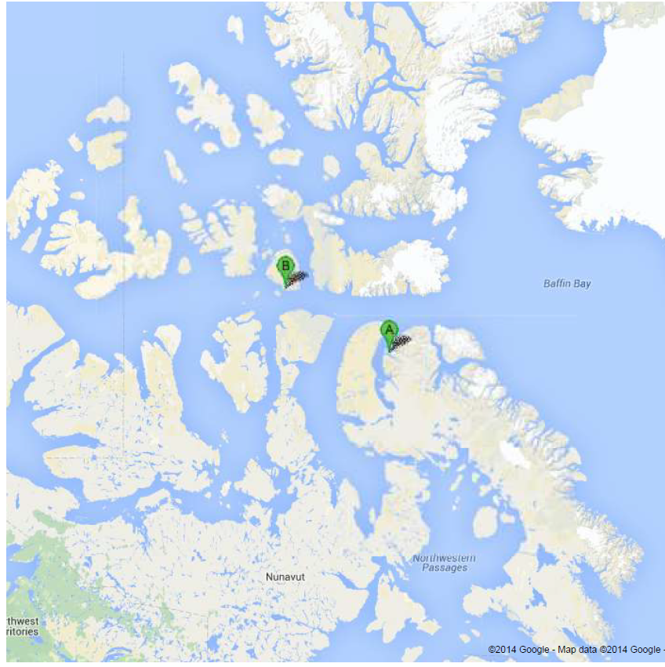
Flights intended within 300 km of Resolute Bay or Arctic Bay. Most of the flying to be conducted over Lancaster Sound. The range rings are approximately
300 km radius
Resolute Bay
Arctic Bay

