Slide 1
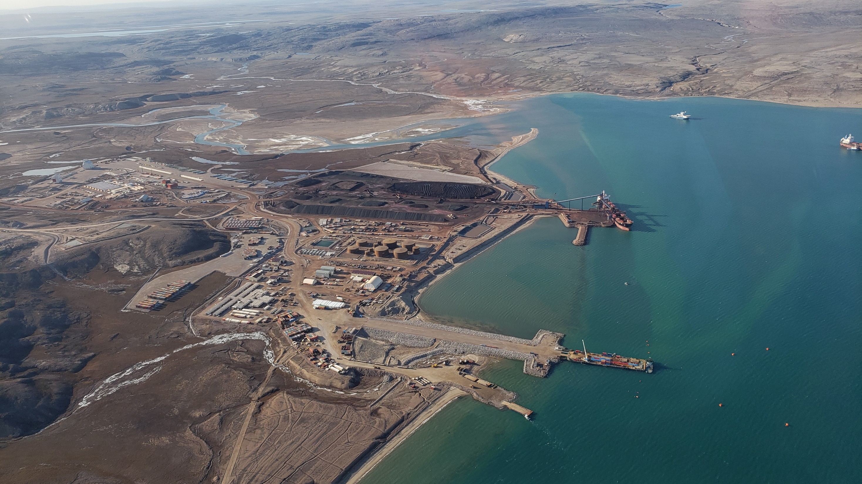

Marine Monitoring and MARINE MITIGATION WORKSHOP
MARY RIVER project
ᑕᕆᐅᒥᒃᖃᐅᔨᒋᐊᖃᑦᑕᕐᓂᖅ ᐸᓚᐅᒥᔾᔪᓯᖅᑐᖅᑕᐅᓯᒪᓚᖓᔪᓪᓗ ᑲᑎᒪᔾᔪᑎᖃᕐᓂᖅ
ᓄᓘᔮᒃ ᐅᔭᕋᒃᑕᕐᕕᖓᓐᓂ
Notes:
Good morning everyone. We will be starting this meeting with a prayer led by _________________.
We have simultaneous interpretation available: English is channel ____ and Inuktitut is channel ____.
My name is Keith Morrison, I am the Manager of Project Monitoring of the Nunavut Impact Review Board and I’ll be chairing today’s meeting. On behalf of the Board, thank you to the community of Pond Inlet for hosting us. I have a few opening remarks to share before we move on to introductions from each of the parties gathered here today.
[change to slide 2]

Slide 2
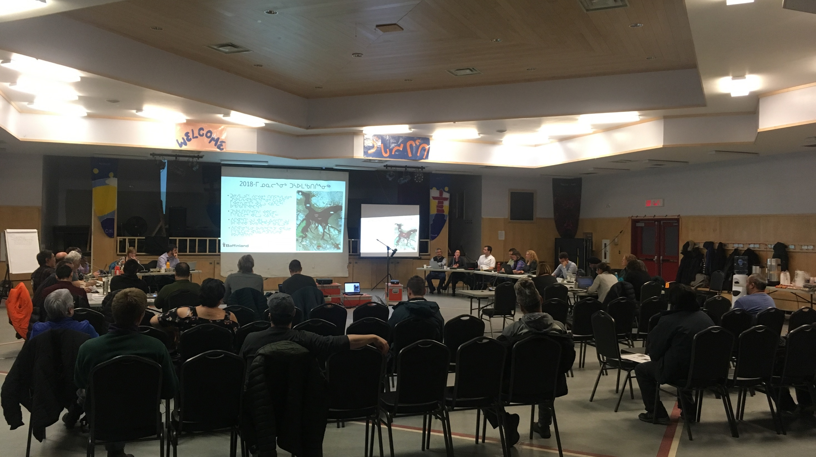

Why are we here?
ᖃᓄᐃᒻᒪᑦ ᑕᒫᓃᑉᐱᑕ?
Host: annual marine monitoring and marine mitigation workshop as directed by the Minister
Engage: The community of Pond Inlet
Ask: What are your marine related concerns about the approved Mary River project?
Listen: Your questions, comments, and concerns
Assess: Effectiveness of current monitoring and mitigation measures
ᑲᑎᒪᑎᑦᑎᔪᖅ: ᐊᕐᕌᒍᑕᒫᑦ ᐃᒪᕐᒥᐅᑕᓂᒃ ᓇᐅᑦᑎᖅᓱᖅᓯᓂᕐᒧᑦ ᐃᒪᕐᒥᐅᑕᓂᒡᓗ ᒥᑭᒡᓕᒋᐊᖅᑎᑦᑎᓂᕐᒧᑦ ᐱᓕᕆᖃᑎᒌᖕᓂᖅ ᑕᐃᒪᐃᖁᔭᐅᓂᕐᒥᓄᑦ ᒥᓂᔅᑕᒥᑦ
ᐃᓚᐅᖃᑕᐅᓂᖅ: ᒥᑦᑎᒪᑕᓕᖕᒥᐅᑦ
ᐊᐱᕆᓗᑎᑦ: ᑭᓲᕙᑦ ᐃᒪᕐᒥᐅᑕᓄᑦ ᐊᒃᑐᐊᓂᓖᑦ ᐃᓱᒫᓘᑎᑎᑦ ᐱᓪᓗᒍ ᐊᖏᖅᑕᐅᓯᒪᔪᒧᑦ ᓄᓘᔮᖕᓂ ᐱᓕᕆᐊᖑᔪᒧᑦ?
ᓈᓚᒡᓗᑎᑦ: ᐊᐱᖅᑯᑎᑎᑦ, ᐅᖃᐅᓯᒃᓴᑎᑦ, ᐃᓱᒫᓘᑎᑎᓪᓗ
ᖃᐅᔨᓴᕐᓗᒍ: ᐊᑑᑎᖃᑦᑎᐊᕐᓂᖓ ᒫᓐᓇ ᖃᐅᔨᓴᖅᑕᐅᔪᑦ ᐊᒻᒪ ᐊᒃᑐᐃᓗᐊᖅᑕᐃᓕᑎᑦᑎᓂᖅ
ᓄᓇᕗᒥ ᐊᕙᑎᓕᕆᔨᑦ ᑲᑎᒪᔨᖏᑦ
2
Nunavut Impact Review Board
Notes:
Meeting Objectives and Structure
HOST: This workshop is hosted by the staff of the Nunavut Impact Review Board as part of the Board’s ongoing monitoring program for the approved Mary River iron mine operated by Baffinland Iron Mines Corporation. The Board’s monitoring program is guided by the terms and conditions of Project Certificate No. 005, as well as the provisions of the Nunavut Agreement and the Nunavut Planning and Project Assessment Act.
ENGAGE: The objective of this workshop is to promote the direct involvement of the community members, community organizations and Qikiqtani Inuit Association in the review of project monitoring data, including information collected under community-based monitoring programs. The NIRB is looking to engage community members in Pond Inlet.
Baffinland has been asked to start sections with brief presentations to provide an update on important topics, provide results from its monitoring and mitigation program for the marine environment, and discuss how lessons learned from previous workshops are being applied to shipping activities for the upcoming shipping season.
ASK AND LISTEN: More immediately, this workshop will allow for direct involvement of the community of Pond Inlet in the review of project monitoring data, including information collected under community-based monitoring programs. We will be listening to your marine related concerns for the approved Mary River project.
ASSESS: Throughout the meetings NIRB staff will be taking down notes and tracking questions and concerns as they are raised on the effectiveness of current monitoring and mitigation measures and a report detailing what we heard will be issued shortly after this workshop is completed.
[change to slide 3]

Slide 3
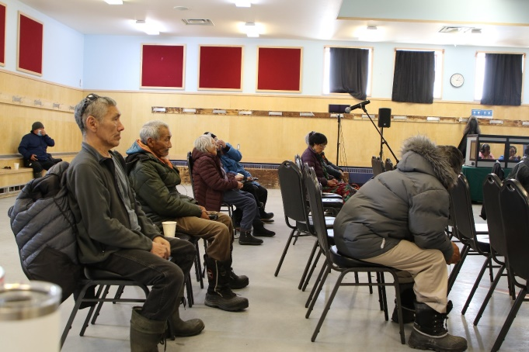
Introductions of participants
ᑭᒃᑰᓂᖏᓐᓄᑦ ᐃᓚᐅᔪᑦ
Qikiqtani Inuit Association
Government of Nunavut
Government of Canada
Baffinland
ᕿᑭᖅᑕᓂ ᐃᓄᐃᑦ ᑲᑐᔾᔨᖃᑎᒌᑦ
ᒐᕙᒪᑦ ᓄᓇᕗᑦ
ᑲᓇᑕᐅᑉ ᒐᕙᒪᒃᑯᖏᑦ
ᓄᓘᔮᑦ
ᐊᔾᔨᓕᐅᖅᑕᐅᓂᑯ ᑭᖑᓪᓕᖅᐹᒥᒃ ᐃᓕᓐᓂᐊᖅᓯᓐᓈᑦ ᑲᑎᒪᓂᕐᒥ ᒪᐃ 2023-ᒥ
Photo from last Workshop in May 2023
Notes:
Introduction of Parties
Let’s take a few moments to go around the room and have everyone quickly introduce themselves and the organization they represent, starting with the staff from the Board. With me here today from the NIRB staff is:
Varun Nayak – Monitoring Officer
Pamela Emingak – Community Outreach Coordinator
Brydon Beattie, NIRB’s Communications and Systems Coordinator managing the audio equipment. If you have trouble with your receivers, please see him for help.
Interpretation is provided by Rhoda Katsak and Michah Arreak
Let’s go around the table for introductions of our workshop participants: <parties introduce themselves>
Starting with Baffinland (please advise if you have representatives participating online):
Qikiqtani Inuit Association
Government of Nunavut
Government of Canada
These organizations have been actively involved in reviewing results from the monitoring program to date and will share their perspectives on how to best to protect the marine environment moving forward.
[change to slide 4]

Slide 4
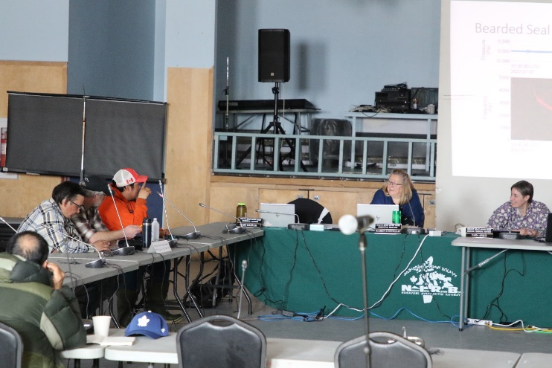
Housekeeping items
ᑲᑎᒪᕕᒻᒥ ᓴᓗᒻᒪᖅᓴᐃᔨᓄᑦ
Facility
Sign-in sheets
Head sets, speak into mics
Refreshments
Phones
Respect at all times
ᑭᓱᓕᕆᕝᕕᒃ
ᐊᑎᓕᐅᕐᕕᒃ
ᐅᖃᓪᓚᒃᓗᑎᑦ ᓂᐱᓄᑦ
ᑕᒧᓗᒐᒃᓴᑦ
ᐅᖄᓚᐅᑎᑦ
ᐃᒃᐱᒋᑦᑎᐊᖏᓐᓇᕐᓗᒍ ᖃᖓᓕᒫᒃᑯᑦ
ᐊᔾᔨᓕᐅᖅᑕᐅᓂᑯ ᑭᖑᓪᓕᖅᐹᒥᒃ ᐃᓕᓐᓂᐊᖅᓯᓐᓈᑦ ᑲᑎᒪᓂᕐᒥ ᒪᐃ 2023-ᒥ
Photo from last Workshop in May 2023
Notes:
Housekeeping items
We have just a few housekeeping items to address before we begin with the introduction of parties:
Emergency Exits, Washrooms
Sign in sheets, pick up your translation headsets which have been and will continue to be cleaned between every use
Use the mics to speak, speak clearly and be mindful of the interpreters. Interpreting headsets are available at the sign in table and the team will be making sure that they are sanitized between uses
Catering - we have tea and coffee for the breaks.
Please turn cellphones off or set them to vibrate for the duration of the meetings
Civility and respect at all times
[change to slide 5]

Slide 5
Overview of Agenda
ᑲᑎᒪᔾᔪᑎᒃᓴᑦ ᕿᒥᕐᕈᔭᐅᓂᖏᑦ
Morning and Afternoon Sessions today
  Baffinland Overview Presentation and updates and Status of Baffinland’s Marine Programs
  Open discussions and opportunities for questions throughout the day
ᐅᓪᓛᒃᑯᑦ ᐅᓐᓄᒃᓴᒃᑯᓪᓗ ᐱᓕᕆᖃᑎᒌᖕᓂᑦ ᐅᓪᓗᒥ ᖃᐅᑉᐸᓪᓗ
  ᓄᓘᔮᖕᓂ ᐅᓂᒃᑳᕐᓂᖅ ᓄᑖᙳᕆᐊᖅᓯᒪᔪᓪᓗ ᖃᓄᐃᓕᖓᓕᕐᓂᖏᓪᓗ ᓄᓘᔮᖕᓂ
  ᐅᖃᖃᑎᒌᖕᓂᖅ ᐱᕕᒃᓴᐃᓪᓗ ᐊᐱᖅᑯᑎᒃᓴᓄᑦ ᐅᓪᓗᓕᒫᖅ
Notes:
Overview of Agenda
The NIRB has previously circulated an agenda [display on screen]:
NIRB Welcome and Opening Remarks
2. Baffinland Overview Presentation
Overview of last shipping season activities and mitigation highlighting actions taken to address the Board’s previous Marine Workshop Recommendations
Overview of the upcoming 2026 shipping season
Question and answer session from the public to Baffinland and Regulators
4. Baffinland Update on its Marine Monitoring Programs
Approach to marine environment effects monitoring and its development of management and mitigation measures, overview of each program and the data collected and projected implications for mitigation required for the 2026 activities
Project-specific shipping notifications for shipping activities, communications protocols for shipping vessels, and public notices
Open discussion topics of interest from previous meetings:
Community-based monitoring programs relevant to the marine environment
Inuit Qaujimajatuqangit (IQ) and marine mammals around the shipping route
Community involvement in decision-making through Mittimatalik Hunters and Trappers Organization and effectiveness in mitigating impacts
Any other topics identified by the community
Wrap up questions from the public to Baffinland and Regulators
7. Workshop conclusion and next steps
As this workshop is being held under the direction of the Minister of Northern Affairs on behalf of the Responsible Ministers, we will be starting the meeting with a brief update presentation, then providing time for Baffinland to present the pertinent information on each topic.
[change to slide 6]

Slide 6

The Mary River Project Certificate
2012
  ᐱᓕᕆᐊᑉ ᓚᐃᓴᖓ #005 ᑐᓂᔭᐅᕗᖅ
  Project Certificate #005 issued
2014
  ᐊᕿᒋᐊᕈᑕᐅᔪᖅ #1 (ᑮᓇᐅᔭᒃᓴᕋᓱᖕᓂᖅ ᑐᒃᓯᕋᐅᑎ) (4.2 ᒥᓕᐊᓐ ᑕᓐ ᐊᕐᕌᒍᑕᒫᑦ)
  Amendment #01 (The Early Revenue Phase Proposal) (4.2 Mtpa)
2018
  ᐊᕿᒋᐊᕈᑕᐅᔪᖅ #2 (ᓴᖅᑭᑕᐅᕙᓪᓕᐊᔪᑦ ᐅᓄᖅᓯᒋᐊᖅᑕᐅᔪᒪᔪᑦ ᑐᒃᓯᕋᐅᑦ) (6 ᒥᓕᐊᓐ ᑕᓐ ᐊᕐᕌᒍᑕᒫᑦ)
  Amendment #03 (The Production Increase Proposal) (6 Mtpa)
2020
  ᐊᕿᒋᐊᕈᑕᐅᔪᖅ #3 (ᐃᔪᒋᐊᖅᑕᐅᓯᒪᓕᖅᑐᖅ ᓴᖅᑭᑕᐅᕙᓪᓕᐊᔪᓄᑦ ᑐᒃᓯᕋᐅᑦ) (6 ᒥᓕᐊᓐ ᑕᓐ ᐊᕐᕌᒍᑕᒫᑦ ᑎᑭᓪᓗᒍ 2021)
  Amendment #04 (The Extension Request to the Production Increase Proposal) (6 Mtpa until 2021)
2022
  ᐊᕿᒋᐊᕈᑕᐅᔪᖅ #4 (ᐃᔪᒋᐊᖅᑕᐅᓯᒪᓕᖅᑐᖅ ᓴᖅᑭᑕᐅᕙᓪᓕᐊᔪᓄᑦ ᑐᒃᓯᕋᐅᑦ) (6 ᒥᓕᐊᓐ ᑕᓐ ᐊᕐᕌᒍᑕᒫᑦ ᐃᓱᐊᓂ 2022)
  Amendment #04(The Extension Request to the Production Increase Proposal) (6 Mtpa for 2022)
2023
  ᐊᕿᒋᐊᕈᑕᐅᔪᖅ #5 (ᐃᑯᐱᒡᕕᓕᕆᔨᒃᑯᑦ ᑐᒃᓯᕋᐅᑦ) (6 ᒥᓕᐊᓐ ᑕᓐᔅ ᐊᕐᕌᒍᒧᑦ 2023-24−ᒧᑦ ᐃᓱᒪᖅᓱᕈᓐᓇᕐᓗᑎᒃ ᐊᐅᓪᓚᖅᑎᑦᑎᔪᓐᓇᕐᓗᑎᒃ 0.9 ᒥᓕᐊᓐ ᑕᓐᔅ−ᑲᓐᓂᕐᓂᒃ ᓴᕕᕋᔭᒃᓴᓂᒃg ᐊᕐᕌᓂᐅᓚᐅᖅᑐᒥ)
  Amendment #05 (Sustain Operations Proposal) (6 Mtpa for 2023-24 with flexibility to ship additional 0.9MT of ore from previous years)
189 ᒪᓕᒃᑕᐅᔪᕐᓴᓕᐊᖑᓯᒪᔪᑦ ᐊᕙᑎᒻᒥᒃ ᐃᓄᓯᕐᒥᒃ ᐱᕙᓪᓕᐊᓂᕐᒥᒡᓗ
189 terms and conditions to limit adverse ecosystemic and socioeconomic effects
Notes:
The original project approved in 2012 consisted of a nominal production of up to 18 million tonnes per year of iron ore from the mine site at Mary River, with transport south on a railway to Steensby Inlet and year-round shipping through Foxe Basin and Hudson Strait to smelters in Europe. The NIRB has been monitoring the project since the initial approval as well as conducting the various required assessments of changes to the project.

Slide 7
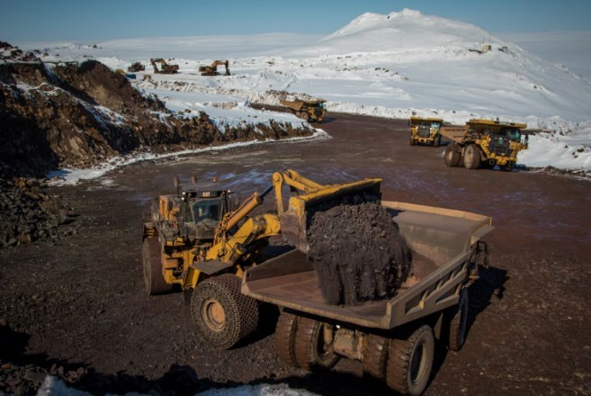

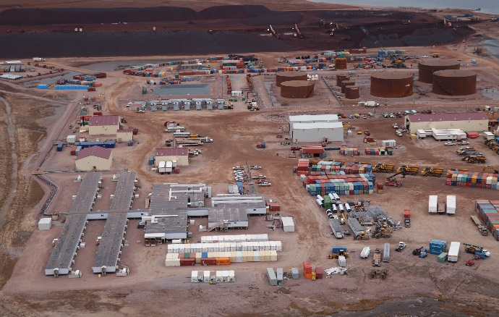
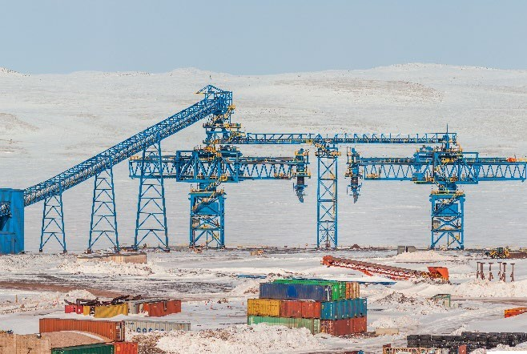
Mary River Project
ᓄᔮᖕᓂ ᐱᓕᕆᐊᖅ
Mine Site
Transportation
Milne Port
Shipping
ᐅᔭᕋᖕᓂᐊᕐᕕᐅᑉ ᐃᓂᒋᔭᖓᓂᑦ
2
ᐅᓯᑲᖅᑕᖅᑕᐅᓂᖓ
3
ᕿᙳᐊᓂ ᑐᓚᒃᑕᕐᕕᒃ
4
ᐅᓯᑲᖅᑕᕐᓂᖅ
1
ᓄᓇᕗᒥ ᐊᕙᑎᓕᕆᔨᑦ ᑲᑎᒪᔨᖏᑦ
7
Nunavut Impact Review Board
Notes:
▪ An Early Revenue Phase was approved next in 2014 and involved trucking iron ore north on the tote road from the mine site to a port site at Milne Inlet. Up to 4.2 million tonnes of ore would be shipped to market each year during the open water season, using ships with up to a 110,000 tonne capacity and requiring as many as 64 round trips per shipping season.
▪ There was no time limit applied to the Early Revenue Phase, so it was recognized that it could one day operate in addition to the production of 18 million tonnes of iron ore at Mary River, with shipment south through Steensby Inlet.
▪ While the original project with the railway and facilities at Steensby Inlet has yet to be constructed, production at the mine site started in September 2014 with shipping from Milne Inlet commencing in August 2015.
That concludes the NIRB’s overview.
[change to slide 8]

Slide 8
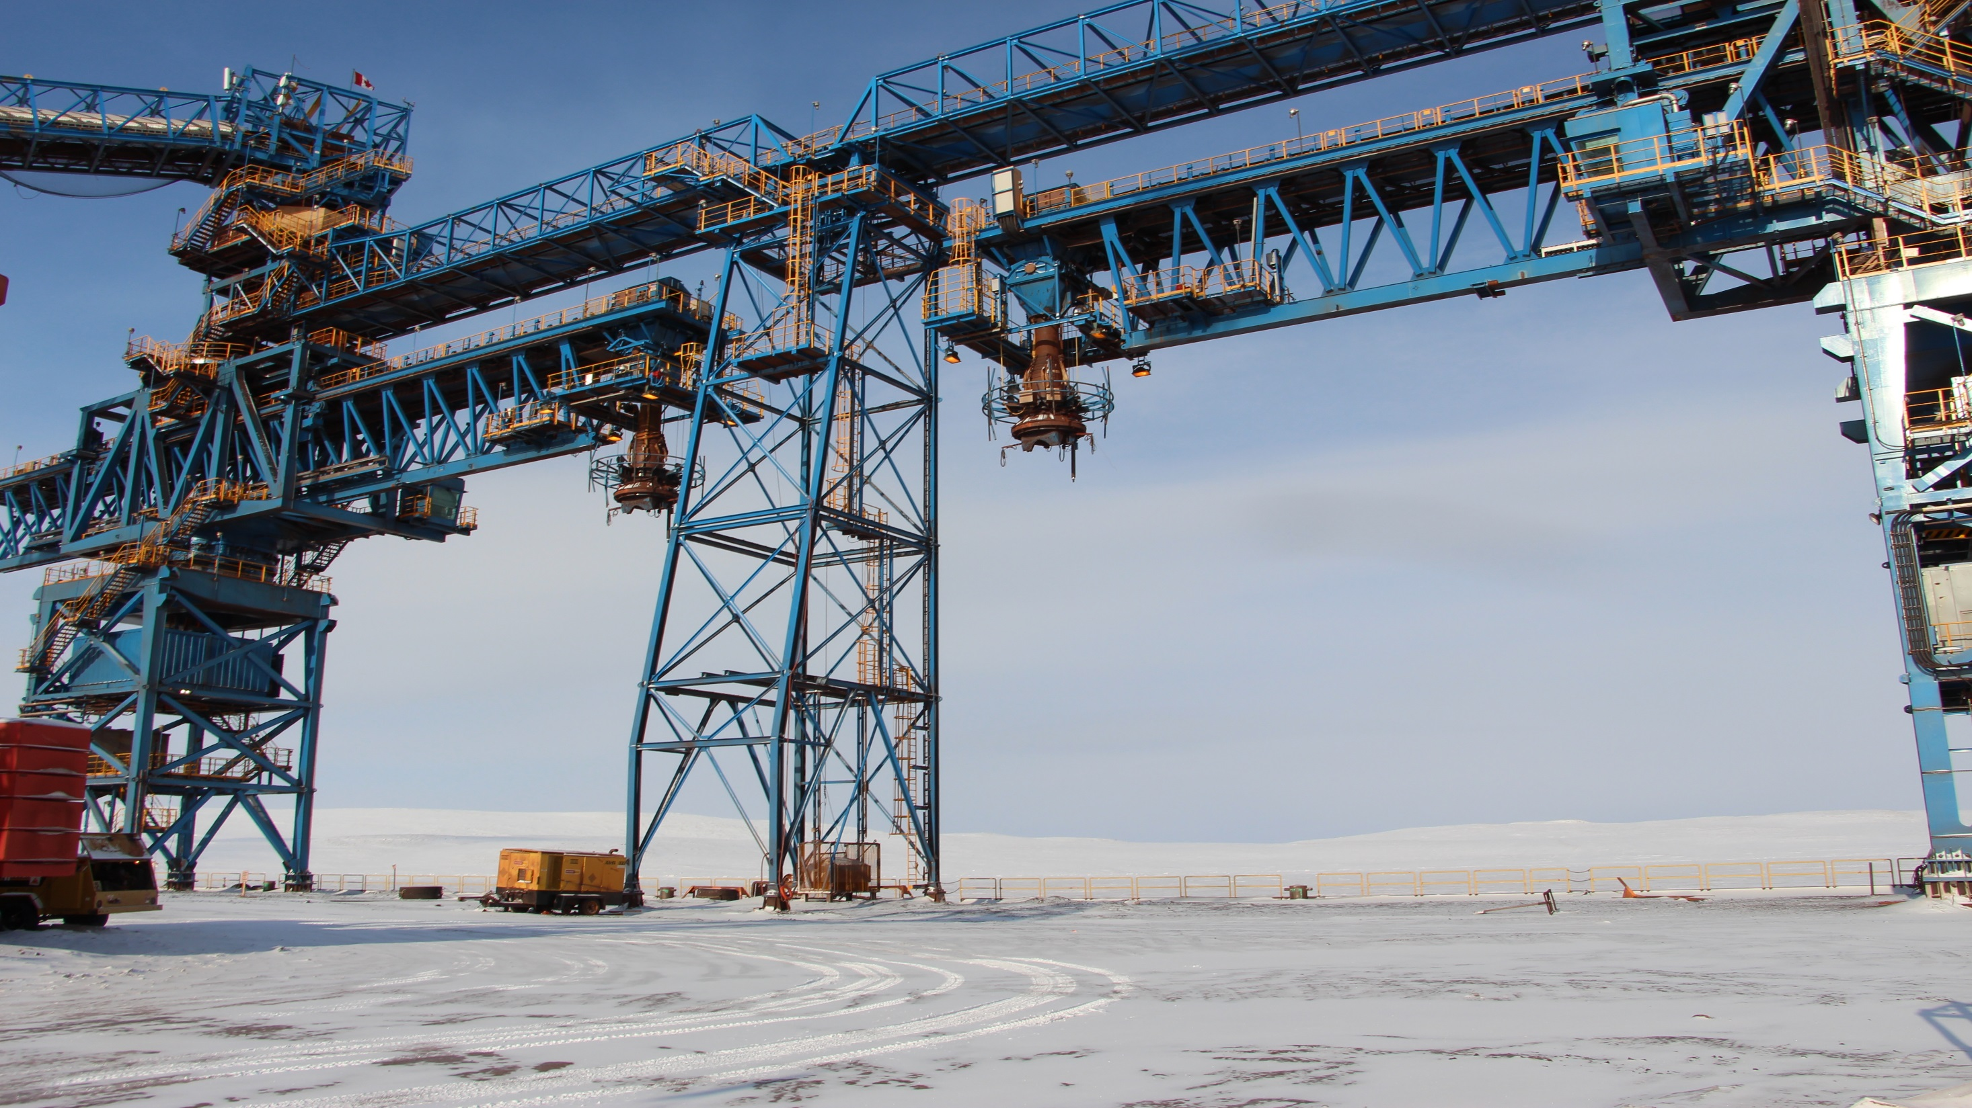
Thank you
ᖁᔭᓐᓇᒦᒃ
Notes:
We will now move to Baffinland’s presentation.
[change presentations]

