Slide 1
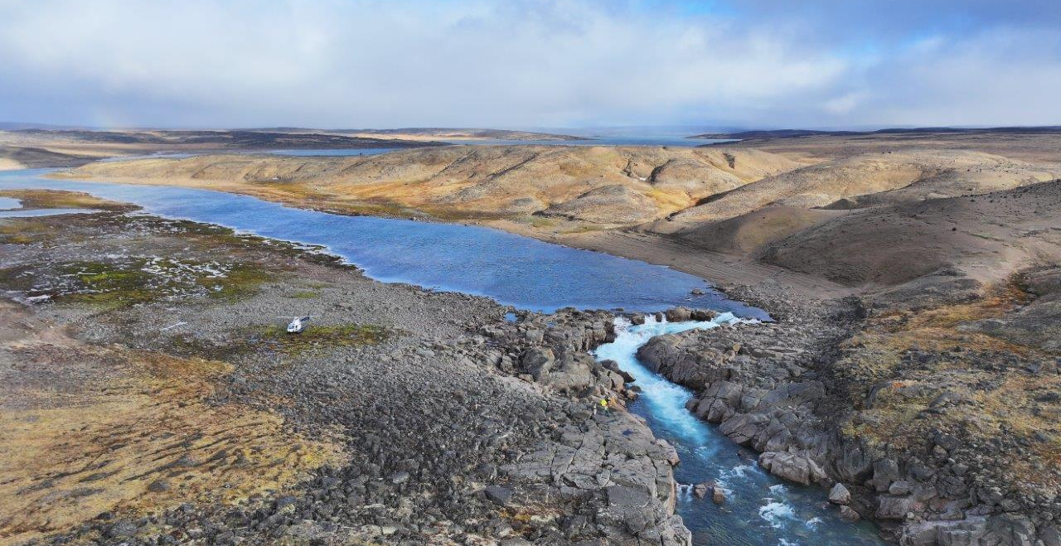

ᐃᖃᓗᐃᑦ ᓄᑭᒃᓴᐅᑏᑦ ᓴᓇᔭᐅᓂᖓ
IQALUIT NUKKIKSAUTIIT PROJECT
ᐅᖃᓪᓚᖃᑎᒌᒃᑕ ᐃᒪᕐᒥᑦ ᐆᒻᒪᖁᑎᖃᐅᑎᖃᕐᓂᖅ
Let’s Talk Water Power
ᔮᓄᐊᕆ 2025
January 2025

Slide 2
ᐃᖃᓗᐃᑦ ᓄᑭᒃᓴᐅᑏᑦ ᓴᓇᔭᐅᓂᖓ
IQALUIT NUKKIKSAUTIIT PROJECT
ᐅᖃᓪᓚᖃᑎᒌᒃᑕ ᐃᒪᕐᒥᑦ ᐆᒻᒪᖁᑎᖃᐅᑎᖃᕐᓂᖅ
Let’s Talk Water Power
ᔮᓄᐊᕆ 2025
January 2025

Slide 3



ᑭᒃᑰᖕᒪᑕ ᓄᓇᕗᑦ ᓄᒃᑭᒃᓴᐅᑏᑦ ᑯᐊᐳᕆᓴᓐ?
WHO IS NNC?
ᓄᓇᕗᑦ ᓄᒃᑭᒃᓴᐅᑏᑦ ᑯᐊᐳᕆᓴᓐ, ᓄᓇᕗᑉ ᓯᕗᓪᓕᖅᐹᖓ100% ᐃᓄᖕᓂᑦ-ᓇᖕᒥᓂᕆᔭᐅᔪᖅ ᓄᓇᒥᑦ ᐆᒻᒪᖁᑎᖃᐅᑎᓕᐅᖅᑎᑦ.
We are Nunavut Nukkiksautiit Corporation, Nunavut’s first 100% Inuit-owned renewable energy developer.
ᐃᓂᖃᖅᑐᒍᑦ ᐃᖃᓗᖕᓂ, ᓴᓇᖃᑦᑕᖅᑐᒍᑦ ᖃᓂᒋᓪᓗᒋᑦ ᓄᓇᓖᑦ ᑕᒪᐃᓐᓂ ᕿᑭᖅᑕᓂ ᓄᓇᖓᓐᓂ ᓄᓇᕗᒻᒥ ᓇᓗᓇᐃᖅᓯᓗᑕ ᓄᓇᒥᑦ ᐆᒻᒪᖁᑎᖃᐅᑎᒃᓴᑦ ᐅᑯᐊᓗ ᒪᓕᑦᑎᐊᕈᓐᓇᖅᑐᑦ ᓄᓇᓖᑦ ᓯᕗᓪᓕᐅᑎᖁᔭᖏᓐᓂᒃ.
ᑕᐃᒪᓗ ᑕᒪᕐᒥᒃ-ᓇᖕᒥᓂᕆᔭᐅᔪᖅ ᕿᑭᖅᑖᓗᒃ ᑯᐊᐳᕆᓴᓐ, ᓯᕗᓕᐅᖅᑎᐅᕗᒍᑦ ᓱᕈᖅᓴᐃᓐᖏᑦᑐᓂᒃ ᐆᒻᒪᖁᑎᖃᐅᑎᒃᓴᓂᒃ ᐊᑐᖅᑕᐅᖔᓕᕐᓂᐊᖅᑐᓂᒃ ᓄᓇᕗᒻᒥ ᐊᒻᒪᓗ ᐊᒃᓱᕉᑎᖃᖅᐳᒍᑦ ᐱᕙᓪᓕᐊᑎᑦᑎᓗᑕ ᓯᕗᓂᒃᓴᑦᑎᓐᓂ ᐆᒻᒪᖁᑎᖃᐅᑎᖏᑦ ᓄᓇᕗᒻᒥ ᐃᓄᖕᓂᑦ-ᐊᐅᓚᑕᐅᓗᑎᒃ, ᐊᑭᑭᑦᑑᓗᑎᒃ, ᓱᕈᖅᓴᐃᓐᖏᓪᓗᑎᒃ, ᐊᒻᒪᓗ ᓱᕋᒃᓴᕋᐃᓐᖏᓪᓗᑎᒃ.
Based in Iqaluit, we work closely with communities across the Qikiqtani Region of Nunavut to identify renewable energy solutions that best align with community priorities.
As a wholly-owned subsidiary of Qikiqtaaluk Corporation, we are a leader in the clean energy transition in Nunavut and strive to ensure the future of energy in Nunavut is Inuit-led, affordable, clean, and reliable.
Notes:
JESS SlLIDE

Slide 4

Why Now?
ᖃᓄᐃᒻᒪᑦ ᒫᓐᓇ?
1857
F
1970
Diesel dependency is not an “if” problem,
it’s a “when” problem
3 trillion barrels
3 ᑐᕆᓕᐊᓐ ᖃᑦᑕᐅᔭᐃᑦ
2023
ᐅᖅᐊᑐᖃᑦᑕᕐᓂᖅᓱᐊᓗᑐᐃᓐᓇᕐᒥᑦ "ᑕᐃᒪᐃᑉᐸᑦ", "ᖃᖓᒃᑯᑦ" ᐊᑲᐅᙱᓕᐅᕈᑎᐅᔪᖅ
E
World Oil Reserves
ᓄᓇᕐᔪᐊᕐᒥ ᐅᖅᓱᖅᑎᕈᑏᑦ

Slide 5

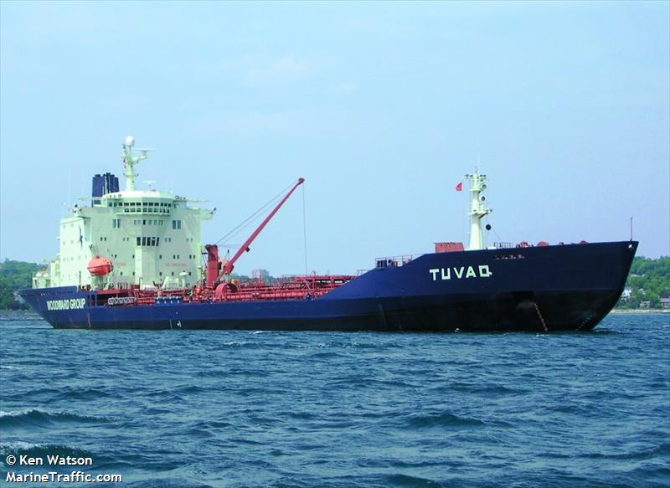








ᒫᓐᓇ ᖃᓄᐃᓕᖓᓕᖅᑲ?
What is the Current State?
Global Oil Market
Oil extraction (1/3rd)
Oil Refinery (1/3rd)
Logistics/taxes (1/3rd)
Unregulated
Energy
ᐆᒻᒪᖅᑯᑎᑦ
ᓄᓇᕐᔪᐊᕐᒥ ᐅᖅᓱᐊᓗᒃ ᓂᐅᕐᕈᑕᐅᔪᑦ
ᐅᖅᓱᐊᓗᒃᑕᕐᓂᖅ (1/3)
ᐅᖅᓱᐊᓗᓕᐅᕐᕕᒃ (1/3)
ᐃᖅᑲᓇᐅᔭᐅᑏᑦ/ᑖᒃᓰᔭᕈᑏᑦ (1/3)
ᒪᓕᒐᓕᐅᖅᑕᐅᓯᒪᙱᑦᑐᖅ
Money
ᐊᑭᖓ
Fuel Subsidy
ᐅᖅᓱᐊᓗᖕᒧᑦ ᐃᑲᔫᑎᑦ

Slide 6




ᑭᓲᕙ ᓯᕗᓂᒃᓴᒥ ᖃᓄᐃᓕᖓᓂᖓ?
What is the Future State?
Local Renewables
Sell power to QEC
Local facility operations
No imports required
Energy
ᐆᒻᒪᖅᑯᑎᑦ
Money
ᐊᑭᖓ
ᓄᓇᓕᖕᓂ ᓄᓇᒥᐅᑕᑦ
ᐆᒻᒪᖅᑯᑎᖃᖅᑎᑦᑎᓗᓂ ᖁᓪᓕᖅ ᐆᒻᒪᖅᑯᑎᓕᕆᔨᒃᑯᑦ ᑎᒥᖁᑖᓄᑦᓄᓇᓕᖕᓂ ᐃᒡᓗᕐᔪᐊᑦ ᐊᐅᓚᓂᕆᔭᖏᑦ
ᓄᓇᓕᖕᓂ ᐃᒡᓗᕐᔪᐊᑦ ᐊᐅᓚᓂᕆᔭᖏᑦ
ᑲᓇᑕᐅᑉ ᓯᓚᑖᓂᙶᖅᑐᓂᒃ ᑎᑭᑎᑦᑎᔭᕆᐊᖃᙱᑦᑐᖅ

Slide 7

ᐃᖃᓗᐃᑦ ᓄᑭᒃᓴᐅᑏᑦ ᓴᓇᔭᐅᓂᖓ
IQALUIT NUKKIKSAUTIIT PROJECT
ᑭᓱ: ᓄᓇᒥᑦ ᐆᒻᒪᖁᑎᖃᐅᑎᖃᕐᕕᒃᓴᖅ ᓴᓇᔭᐅᔪᖅ
ᖃᓄᐃᒻᒪᑦ: ᓅᓐᓂᐊᕐᒪᑕ ᐃᖃᓗᐃᑦ ᓱᕈᖅᓴᐃᓐᖏᑦᑐᒧᑦ, ᓄᓇᒥᑦ ᐆᒻᒪᖁᑎᖃᐅᑎᒃᓴᓄᑦ
ᖃᓄᖅ: ᐃᒫᒍᑦ ᐆᒻᒪᖁᑎᖃᐅᑎ ᓄᒃᑭᒃᓴᐅᑎᖓ ᐆᒻᒪᖁᑎᖃᐅᑎᖃᕐᕕᐅᓂᐊᖅᑐᖅ
(ᑏᓱ ᐊᐅᓚᐅᑎᖃᕐᕕᖓ ᓱᓕ ᖃᓄᐃᓕᔪᖃᖅᐸᑦ ᐊᑐᖅᑕᐅᔪᓐᓇᕐᓂᐊᖅᑐᖅ ᐊᒻᒪᓗ ᑐᐊᕕᕐᓇᖅᑐᖃᖅᐸᑦ ᐃᑭᑕᐅᔪᓐᓇᕐᓗᓂ)
What: A renewable power project
Why: To move Iqaluit towards clean, renewable power
How: Water power plant as the main renewable power source
(diesel plant remains as back-up and emergency power source)
Notes:
JESS SLIDE – Why NNC is doing this project and how it will be achieved
What the project is -
Why NNC is doing the project –
How the project will be achieved -
What the benefits are for Inuit: Locally-generated water power offers energy sovereignty, energy security, and it keeps money Iqalungmiut spend on electricity in Nunavut, rather than flowing out to southern diesel suppliers. It would also get rid of the air pollution and smell of diesel exhaust that hangs over Iqaluit. Switching to water power is a meaningful way of reducing our carbon footprint in line with Canada’s climate change goals.

Slide 8


ᐃᒪᓐᓇ ᐱᓕᕆᓯᒪᓕᖅᑐᒍᑦ
WHAT WE HAVE DONE
ᐅᕙᓃᑉᐳᒍᑦ
“ᐅᖃᓪᓚᖃᑎᒌᒃᑕ ᐃᒪᕐᒥᒃ ᐆᒻᒪᖁᑎᖃᐅᑎᖃᕐᓂᕐᒥᒃ”
ᔫᓐ 2023
“Let’s Talk Energy”
June 2023
“ᑐᓴᖅᑕᐅᔪᓐᓇᖅᐳᓯ ᐅᖃᐅᓯᒃᓴᑦᓯᓐᓂᒃ”
ᓄᕕᐱᕆ 2023
“Have your Say”
November 2023
ᓱᒃᑲᖅᑕᕐᓂᖓ
Project Phase
WE ARE HERE
ᐃᓱᒪᓕᐅᕆᔭᕆᐊᓕᑦ
Decision Gate
ᑮᓇᐅᔭᒃᓴᖃᑦᑎᑕᐅᓗᑎᒃ ᐸᕐᓇᐃᓗᑎᒃᓗ ᐊᒻᒪᓗ ᖃᓄᖅ ᓴᓇᓯᒪᓂᐊᕐᒪᖔᑦ
ᓇᓗᓇᐃᑦᑎᐊᖅᓯᒪᔪᑦ ᓴᓇᔭᕆᐊᖃᖅᑐᓂᒃ ᐊᒻᒪᓗ ᐱᔪᓐᓇᐅᑎᒃᓴᖏᓐᓄᑦ
ᓇᓗᓇᐃᕐᓗᒋᑦ ᐱᕕᖃᕐᑎᑦᑎᔪᑦ
ᑲᔪᓯᔪᓐᓇᕐᒪᖔᑕ ᑲᔪᓯᔪᓐᓇᓐᖏᒻᒪᖔᑕᓘᓐᓃᑦ
ᐱᖁᑎᑦ ᐃᖏᕐᕋᓯᑎᑕᐅᓗᑎᒃ
ᓴᓇᓗᑎᒃ
1
2
3
4
5
6
Identify Opportunity
Feasibility
Front-End Engineering and Design (FEED)
Detailed Engineering and Permitting
Construction
Asset Operation
?
?
ᓱᕈᖅᓴᐃᓐᖏᑦᑐᓂᒃ ᐆᒻᒪᖁᑎᖃᐅᑎᒃᓴᓂᒃ ᕿᓂᖅᑕᐅᒃᑲᓐᓂᕈᓐᓇᖅᐸ?
ᖃᓄᕆᑦᑐᓂᒃ ᓱᕈᖅᓴᐃᓐᖏᑦᑐᑦ ᐆᒻᒪᖁᑎᖃᐅᑎᑦ ᐊᒻᒪᓗ ᓇᓂ?
ᐅᓇ ᑕᖏᖓ ᑐᑭᖃᖅᐸ ᐊᒻᒪᓗ ᓴᓇᔭᐅᓂᖓᓄᑦ ᐱᕚᓪᓕᕈᑎᒋᔪᓐᓇᖅᐸ ᐱᔪᓐᓇᐅᑎᑖᕈᓐᓇᕐᓂᐊᕐᒪᑕ?
ᓴᓇᔭᐅᔪᒪᔪᖅ ᓴᓇᔭᐅᔭᕆᐊᖃᖅᐸ?
Should clean energy be further explored?
What type of clean energy and where?
Does the concept make sense and should the Project advance to permitting?
Should the project be built?
Notes:
JESS SLIDE:
Phase 1:
Identify Opportunity
NNC identified the value to Iqalungmiut in exploring clean power solutions to meet Iqaluit’s needs. NNC completed a Technical and Economic Feasibility Review, a Tusaqtavut Study on Inuit land-use, and a desktop Environmental Survey
Decision Gate 1:
Should clean power be further explored for Iqaluit?
Inuit leadership from Qikiqtaaluk Corporation and Qikiqtani Inuit Association supported doing more studies to find the best path forward
Phase 2 :
Feasibility
17 different power system options were identified at sites near Iqaluit, including different types of water power, wind power, a combination of water and wind, and continuing with diesel.
Decision Gate 2:
What type of clean power and where?
Through a ranked ballot vote, Rightsholders, stakeholders, Iqalungmiut, and partners approved conventional water power at the Kuugaluk River site as their preferred option.
We are now at Phase 3 – Front End Engineering and Design Phase
Transition to Greg: Greg will now go into more detail about how the engineering has progressed so far and led us to the current project concept.

Slide 9




ᐃᖃᓗᐃᑦ ᓄᒃᑭᒃᓴᐅᑏᑦ ᓴᓇᔭᐅᔪᖅ ᑐᕌᖅᑕᖏᑦ
IQALUIT NUKKIKSAUTIIT PROJECT GOALS
ᐃᓅᓯᓕᕆᓂᖅ
ᐊᔪᖏᑎᑦᑎᔪᖅ ᐃᓄᐃᑦ ᓇᖕᒥᓂᖃᖅᑐᑦ ᐆᒻᒪᖁᑎᖃᐅᑎᒥᖕᓂᒃ ᐱᖁᑎᖃᕐᓗᑎᒃ
ᑲᔪᖏᖅᓴᐃᔪᑦ ᓄᓇᓕᖕᓂ ᒪᑭᒪᓇᓱᐊᕈᑎᒃᓴᐅᓗᑎᒃ ᐱᕈᕈᑕᐅᓗᑎᒃ ᐊᒻᒪᓗ ᐃᖅᑲᓇᐃᔮᖃᖅᑎᑦᑎᓗᓂ
ᐱᐅᓯᕚᓪᓕᕐᓗᓂ ᐃᖃᓗᐃᑦ ᐆᒻᒪᖁᑎᖃᐅᑎᖃᕐᕕᖓ ᐊᒻᒪᓗ ᐊᑦᑕᕐᓇᖅᑐᒦᖁᓇᒋᑦ
ᐃᓄᐃᑦ ᐋᓐᓂᐊᖃᑦᑕᓐᖏᓂᖅᓴᐅᓕᕐᓗᑎᒃ
Social
Enable Inuit ownership of energy assets
Encourage local economic growth and job creation
Enhance Iqaluit’s energy sovereignty and security
Improved public health
  Environmental
  Reduce Iqaluit’s dependency on diesel
  Minimize carbon emissions
  Improved environmental quality
ᐊᕙᑎᒧᑦ
ᐊᑦᑎᒃᓯᑎᑦᑎᔪᖅ ᐃᖃᓗᐃᑦ ᐊᑐᓗᐊᕐᓂᖏᓐᓂᒃ ᑏᓱᒥᒃ ᐊᒻᒪᓗ
ᒥᑭᒡᓕᑎᑦᑎᔪᖅ ᐸᐅᕐᒥᒃ ᐃᓯᐊᕿᔪᒥᒃ
ᐱᐅᓯᕚᓪᓕᖅᓱᖅ ᓯᓚᕗᖅ ᐊᓂᖅᓵᖅᑐᕐᕕᒋᓪᓗᒍ
ᒪᑭᒪᓇᓱᐊᕐᓂᕐᒧᑦ
ᑮᓇᐅᔭᑦ ᐱᓯᒪᒐᔭᖅᑕᖏᑦ ᓄᓇᕗᑦ ᐃᓗᐊᓃᓪᓗᓂ
ᐊᑭᒡᓕᒋᐊᕐᓗᑎᒃ ᐆᒻᒪᖁᑎᖃᐅᑎᓄᑦ ᓄᓇᕗᒻᒥ (ᐊᐅᓚᑕᐅᔪᑦ ᓄᓇᕗᑦ ᒐᕙᒪᒃᑯᓂᑦ)
ᐊᑦᑎᒃᓯᒋᐊᖅᑎᑦᑎᔪᖅ ᐅᕝᕙᓘᓐᓃᑦ ᒐᕙᒪᒃᑯᓂᑦ ᐊᑭᒡᓕᒋᐊᕈᑎᖃᓐᖏᓪᓗᑎᒃ ᑎᑭᑎᑕᐅᖃᑦᑕᖅᑐᓄᑦ ᐃᓵᕿᓲᓄᑦ ᐅᖅᓱᐊᓗᖕᓄᑦ
Economic
Keep money within Nunavut
Lower energy costs in Nunavut (controlled by GN)
Lower or no government subsidies for imported fossil fuels
Notes:
JESS SLIDE –
(uninterrupted availability of energy courses at an affordable price)
What the project is -
Why NNC is doing the project –
How the project will be achieved -
What the benefits are for Inuit: Locally-generated water power offers energy sovereignty, energy security, and it keeps money Iqalungmiut spend on electricity in Nunavut, rather than flowing out to southern diesel suppliers. It would also get rid of the air pollution and smell of diesel exhaust that hangs over Iqaluit. Switching to water power is a meaningful way of reducing our carbon footprint in line with Canada’s climate change goals.

Slide 10
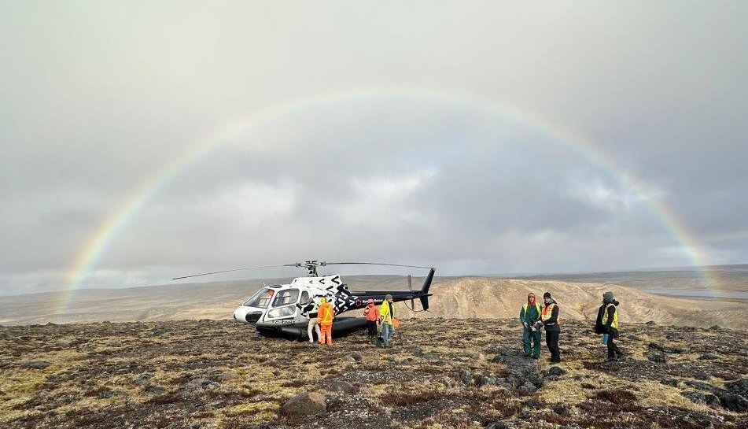
ᑭᒃᑰᕙᑦ ᐃᑯᒪᓕᕆᔨᒃᑯᑦ ᐱᓕᕆᖃᑎᒌᑦ?
WHO IS THE ENGINEERING TEAM?
Tetra Tech ᐅᑯᐊ ᐃᑯᒪᓕᕆᔨᒃᑯᑦ ᐊᐅᓚᐅᓯᕆᔨᑦ ᐱᓕᕆᖃᑎᒌᒍᔪᑦ
3,500+ ᓴᖕᖏᓂᖃᖅᑐᒥᒃ ᓴᓇᔪᑦ
ᓯᓚᕐᔪᐊᓕᒫᒃᑯᑦ ᐱᓕᕆᖃᑦᑕᖅᓯᒪᓂᑯᑦ ᐃᒫᒍᑦ ᐆᒻᒪᖁᑎᖃᐅᑎᓕᖅᖢᑎᒃ ᐃᓚᒋᔭᐅᕗᑦ ᓴᓇᔭᐅᔪᓂᑦ ᐱᓕᕆᖃᑎᒋᓪᓗᒋᑦ ᐊᓪᓚᐃᑦ.
ᐃᑲᔪᖅᑐᑦ ᓄᓇᕗᑦ ᓄᒃᑭᒃᓴᐅᑏᑦ ᑯᐊᐳᕆᓴᓐ ᐅᑯᓂᖓ:
  ᐸᕐᓇᐃᓂᖅ
  ᐊᕙᑎᑦᑎᓂᒃ ᐃᓕᑦᑎᓇᓱᖕᓂᖅ
  ᐊᐅᓚᐅᓯᕆᓂᖅ
  ᓇᑉᐸᖅᑕᐅᓕᖅᐸᑕ ᓴᓇᔭᐅᓗᑎᒃ ᐊᐅᓚᑦᑎᓂᖅ
Tetra Tech is the engineering team
3,500+ power projects
Worldwide experience with water power projects including projects in partnership with First Nations.
Supporting NNC with:
  planning
  environmental studies
  engineering
  construction management
Notes:
Introduce Greg/Tetra Tech
Transition to next slide: “Greg, can you introduce yourself and tell us about some of Tetra Tech’s past water power project experience”

Slide 11
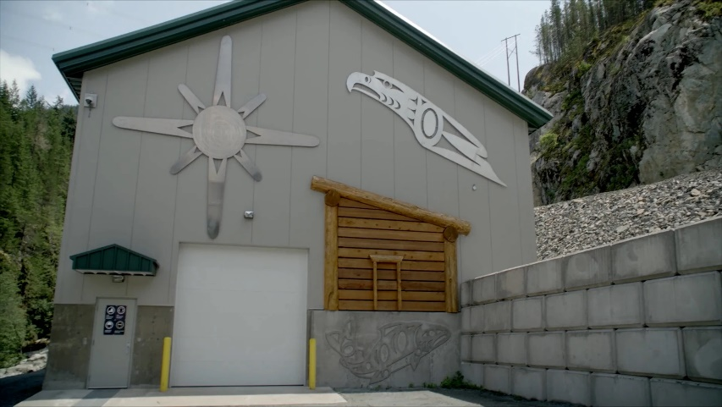
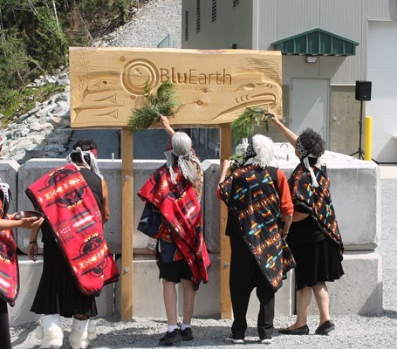

TETRA TECH ᓴᓇᔭᐅᔪᖅ ᐱᓕᕆᓚᐅᖅᓯᒪᔪᑦ – CULLITON CREEK
TETRA TECH PROJECT EXPERIENCE– CULLITON CREEK
ᓇᓂ: ᓯᑯᐊᒥᔅ, ᐳᑎᓯ ᑲᓚᑉᐱᐊ ᓄᓇᖁᑎᖓᑦ ᓯᑯᐊᒥᔅ ᐊᓪᓚᐃᑦ
ᖃᓄᖅ: 15 MW ᒥᒐ ᒍᐊᑦ ᐃᒫᓂᑦ ᐆᒻᒪᖁᑎᖃᐅᑎᖃᕐᕕᒃ
ᑭᓇ: BluEarth ᓄᓇᒥᐅᑕᓕᕆᔪᑦ ᐱᓕᕆᖃᑎᒋᓪᓗᒋᑦ ᓯᑯᐊᒥᔅ ᐊᓪᓚᐃᑦ
Where: Squamish, BC in the traditional territory of the Squamish Nation
What: 15 MW water power plant
Who: BluEarth Renewables in partnership with Squamish First Nation
“ᓈᓚᑦᑎᐊᓲᑦ, ᑐᓴᓲᑦ ᖃᓄᖅ ᐅᖃᖅᑕᐅᔪᓂᒃ...ᖁᔭᓕᑦᑎᐊᖅᑐᑦ ᐃᓚᐅᑎᑕᐅᒐᒥᒃ: ᐊᑎᓕᐅᕆᓂᖅ, ᐱᔭᕆᐅᖅᓴᑎᑦᑎᓂᖅ, ᐃᓕᓐᓂᐊᕐᑎᑦᑎᓂᖅ ᐊᒻᒪᓗ ᑮᓇᐅᔭᓕᐅᖅᑎᑦᑎᓂᖅ ᓄᓇᓕᖕᓂ”
- ᐊᖓᔪᖅᑳᖅᖓ ᓯᑯᐊᒥᔅ ᐊᓪᓚᐃᑦ
“They listen, they hear what the Nations are saying. . . very appreciative of being involved; naming, training, education and finally bringing revenue for our Nation”
– Chief of Squamish First Nation
Notes:
GREG SLIDE
Introduce yourself
What/Where the Culliton Creek project is
Who owns the project
Relevant project details:
Example of a water power project that advanced very successfully in partnership with local First Nations.
15 MW – same size
During construction the project provided over 200,000 worker hours of employment of which, approximately 13% were from the Squamish Nation.
Integrated artwork features into the building designed by the Nations
Other significant things to note re First Nations partnership, EIA, project outcomes, etc that are related to this project?

Slide 12
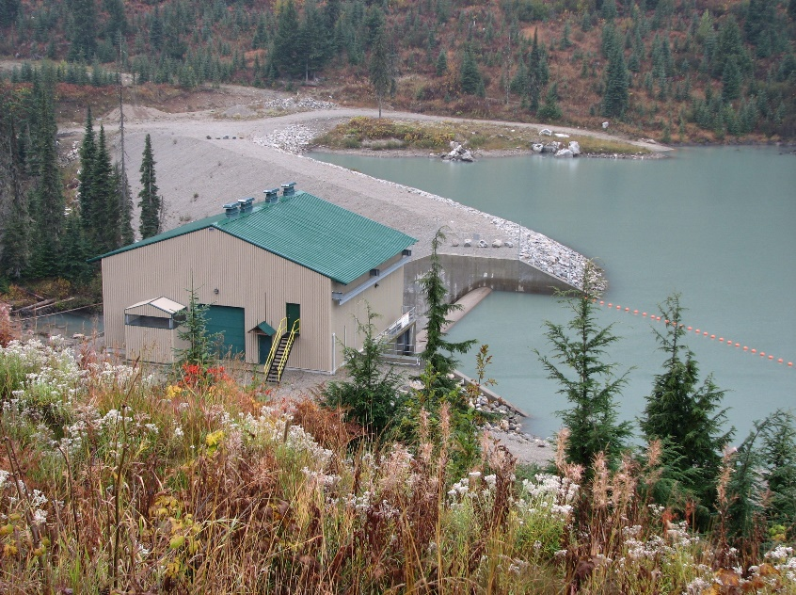
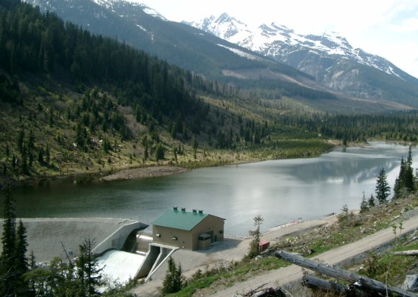
TETRA TECH ᓴᓇᔭᐅᔪᖅ ᐱᓕᕆᓚᐅᖅᓯᒪᔪᑦ – PINGSTON CREEK
TETRA TECH PROJECT EXPERIENCE– PINGSTON CREEK
ᓇᓂ: ᐅᓕᕕᐅᓯᑐᓗᒃ, ᐳᑎᓯ ᑲᓚᑉᐱᐊ
ᖃᓄᖅ: 45 ᒥᒐ ᒍᐊᑦ
ᑭᓇ: ᑲᑐᑎᔭᐅᓯᒪᔪᖅ ᐊᕙᑖᓂᑦ ᑲᓇᑕᒥᐅᑦ ᐃᒫᒍᑦ ᐆᒻᒪᖁᑎᖃᐅᓯᐅᖅᑎᑦ (ᐱᑎᓯ ᑲᓚᑉᐱᐊ) ᑎᒥᖓ ᐊᒻᒪᓗ Great Lakes ᐆᒻᒪᖁᑎᖃᐅᑎᖃᕐᕕᒃ ᑎᒥᖓ
ᑰᒃ ᓴᐳᓗᑖ ᑎᒥᖓᑕ ᓴᓇᓯᒪᓂᖓ: ᐊᖏᔪᖅ ᖃᓕᕇᓕᖅᓯᓯᒪᔪᑦ ᑰᒃ ᓯᒥᖓ (ᐊᔾᔨᑲᓴᖓ ᐃᖃᓗᐃᑦ ᒫᓐᓇ ᑕᖏᒃᓴᖓᑕ)
Where: Revelstoke, BC
What: 45 MW
Who: Joint Venture between Canadian Hydro Developers (B.C.) Inc. and Great Lakes Power Limited
Dam Design: sheet pile dam (similar to Iqaluit’s current concept)
Notes:
GREG SLIDE:
What/where the project is
Who owns the project
Relevant Project Details:
An integral part of the project was that fish habitat was enhanced by installing rock reefs and log jam structures to create safe spawning grounds and refuge for fish during low water levels. A fish spawning channel was also constructed.
12 metre high sheetpile rock fill dam – relevance to Iqaluit dam design?
Other Connections to Iqaluit project??

Slide 13
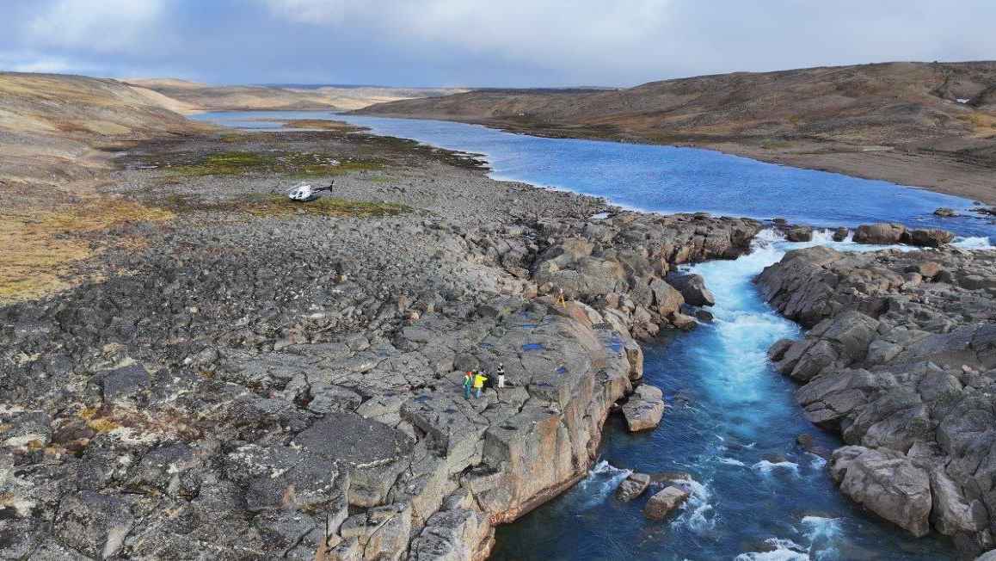
ᐃᒪᓐᓇ ᐃᓱᒪᖃᓚᐅᖅᑐᒍᑦ
WHAT WE THOUGHT
ᒪᓕᒃᖢᒍ ᓱᒃᑲᖅᑕᕐᓂᖓ 2 ᖃᕆᓴᐅᔭᒃᑯᑦ ᐃᓕᑕᐅᓇᓱᒃᓯᒪᔪᑦ, ᑰᒑᓗᒃ ᐃᓂᖓ ᓂᕆᐅᓇᖅᑐᖅ ᑎᑭᐅᑎᑦᑎᐊᖅᓯᒪᓂᖓᓂ 100% ᐃᖃᓗᐃᑦ ᐆᒻᒪᖁᑎᖃᐅᑎᒋᔭᕆᐊᖃᖅᑕᖏᓐᓄᑦ, ᐅᕝᕙᓘᓐᓃᑦ 15 ᒥᒐ ᒍᐊᑦ, ᑕᒪᐅᓐᓇ ᐃᒫᒍᑦ ᐆᒻᒪᖁᑎᖃᐅᑎᖃᕐᕕᖃᕐᓗᓂ ᐊᑕᐅᓯᕐᒥᒃ ᐃᒪᖃᕐᕕᖃᕐᓗᓂ.
ᓱᒃᑲᖅᑕᕐᓂᖓ 2: ᑲᔪᓯᔪᓐᓇᕐᒪᖔᑕ ᑲᔪᓯᔪᓐᓇᓐᖏᒻᒪᖔᑕ
17 ᐊᔾᔨᒌᓐᖏᑦᑐᑦ ᐆᒻᒪᖁᑎᖃᐅᑎᖃᕐᕕᑦ ᓂᕈᐊᖅᑕᐅᓯᒪᔪᓐᓇᖅᑐᑦ
2
Phase 2: Feasibility
17 different power system options
Based on Phase 2 desktop studies, the Kuugaluk River site was predicted to meet 100% of Iqaluit’s electricity needs, or 15 MW, through a conventional water power plant with a single reservoir.
ᐃᓱᒪᓕᐅᕆᕕᖓᑦ 2:
ᑰᒑᓗᒃ ᐃᓂᒃᓴᖓ ᓂᕈᐊᖅᑕᐅᓯᒪᔪᖅ
Decision Gate 2:
Kuugaluk River site preferred option
Notes:
GREG SLIDE:
As Jess mentioned, as an outcome of Phase 2, the Kuugaluk River site was approved as the preferred options.
At this stage, the Kuugaluk River site was predicted to meet 100% of Iqaluit’s electricity needs through a conventional water power plant that had a single dam and reservoir.
To meet 100% of Iqaluit’s electricity needs, we need a water power plant that has a minimum plant capacity of 15 MW.
Jess prompt question: What is plant capacity? (how much electricity can be produced)
Jess prompt question: How many homes can 15 MW provide electricity to? (provides enough power for approx. 5900 homes, Iqaluit currently has 2710 homes, so this plant will provide electricity to homes, commercial and institutional buildings in Iqaluit now, and into the future. )

Slide 14
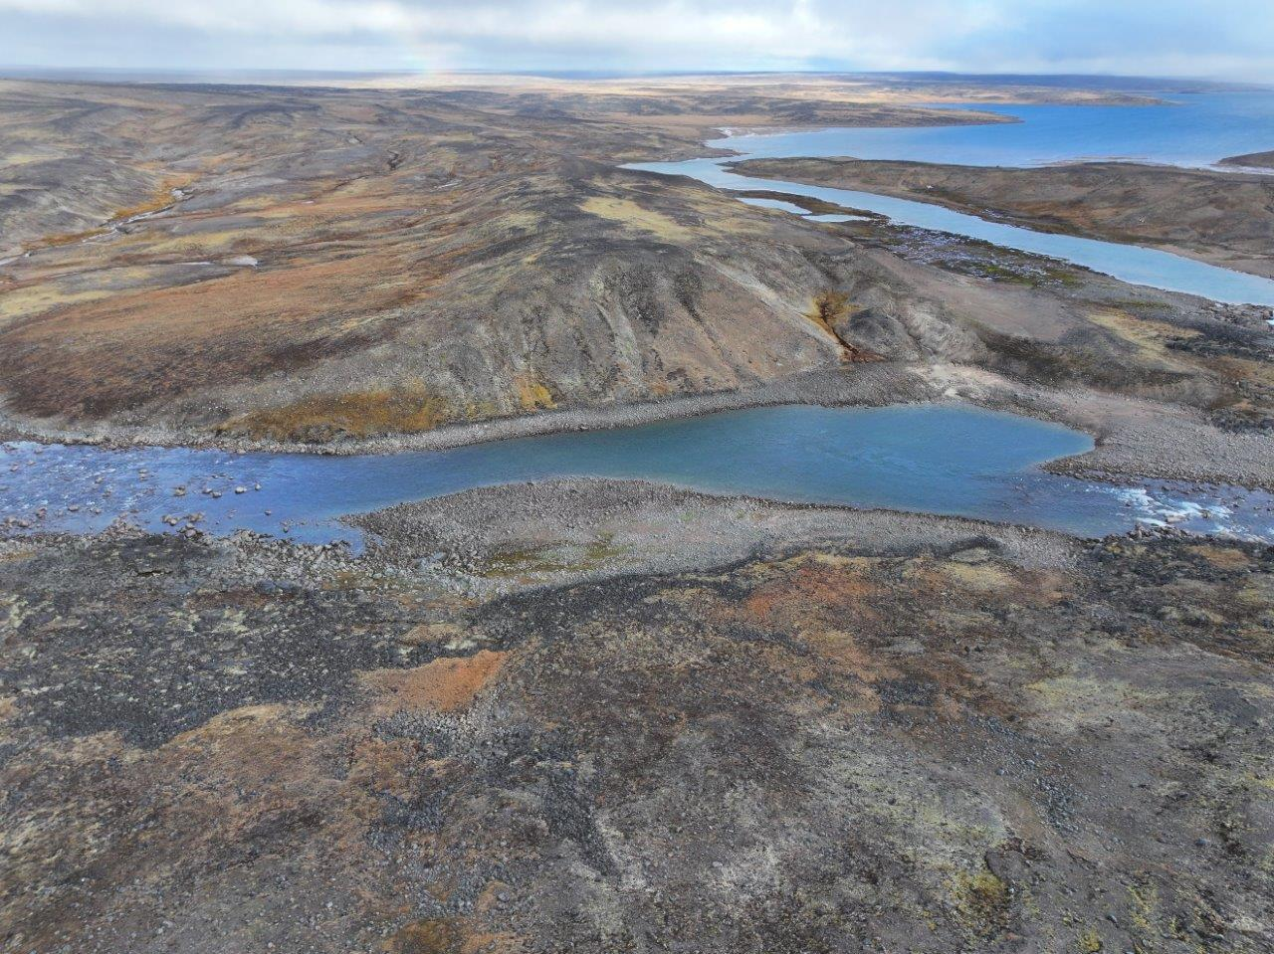

ᐃᒪᐃᑦᑐᓂᒃ ᓇᓂᓯᓚᐅᖅᑐᒍᑦ
WHAT WE DISCOVERED
2024 ᐃᓂᖓ ᐳᓛᖅᑕᐅᓚᐅᖅᑐᖅ
ᑭᓇ: ᓴᓇᔭᐅᔪᒥᒃ ᐱᓕᕆᖃᑎᒌᑦ
ᖃᖓ: ᓯᑎᐱᕆ 26-30, 2024
ᐱᔾᔪᑖᑦ: ᑕᑯᔭᖅᑐᖅᑐᑦ ᑭᓱᖃᕐᒪᖔᑦ: ᑰᒑᓗᒃ ᓴᓇᔭᐅᔪᖅ ᐃᓂᖓ
ᐃᒪᖃᐅᑎᖃᕐᕕᖓ (ᑕᓯᖅ)
ᐃᓂᖓ ᓯᒥᐊᑕ, ᑕᑕᓗᐊᓕᕈᓂ ᑭᕕᕕᒃᓴᖓ, ᐃᔾᔪᔪᖅ ᓱᓪᓗᖅ, ᐊᒻᒪᓗ ᐊᐅᓚᐅᑎᖃᕐᕕᖓ
ᐊᑐᖅᑐᐊᕐᕕᐅᔪᑦ
2024 Site Visit
Who: Project team
When: September 26-30, 2024
  Intent: Visual observations of the Kuugaluk River project site:
      Reservoir (lake)
      Locations for the dam, spillway, penstock, and powerhouse
      Borrow sources
ᐊᑑᑎᖃᖅᑐᑦ ᓇᓂᔭᐅᓯᒪᔪᑦ: ᑐᐊᐸᓕᕆᓂᖅᓴᐅᓕᕐᓗᑎᒃ ᖃᕆᓴᐅᔭᒃᑯᑦ ᐃᓕᑦᑎᓇᓱᓚᖑᖅᑕᖏᓐᓂᒃ ᓂᕆᐅᒃᑐᑦ ᑕᐃᒪᐃᒻᒪᑦ ᐅᔭᕋᓱᒃᔪᒃ ᐃᔾᔪᔫᖅ ᐃᔾᔪᓂᖅᓴᖅ ᓂᕆᐅᒋᔭᐅᓚᐅᖅᑐᒥᑦ.
    Key Finding: more gravel than desktop studies predicted;
    therefore, bedrock is deeper than we thought
11
Notes:
GREG SLIDE:
The project team, including Tetra Tech and NNC representatives, did the first site visit September 26-30, 2024.
The main intent of the site visit was to go to the Kuugaluk River site to make visual observations about the existing lake which will be the water power plant reservoir, to make observations about the ground conditions in and around the where the water power plant and its components will be, including the dam and spillway, the penstock, and the powerhouse. We will get into what these are in the next slides.
We also identified options for borrow sources.
Jess question: “What are borrow sources” (locations that we can use to provide gravel and other granular material needed for the project – such as the access road, . . ?)
Jess question: “So what did your visual observations tell you?” (key finding was that there is more gravel at the project site than what the desktop studies predicted. At this point, we do not know the depth to bedrock)
Jess question: “Why is knowing the depth to bedrock so important” (how deep the bedrock is will have an impact on what the water level of the reservoir can be and how the dam needs to be constructed)

Slide 15
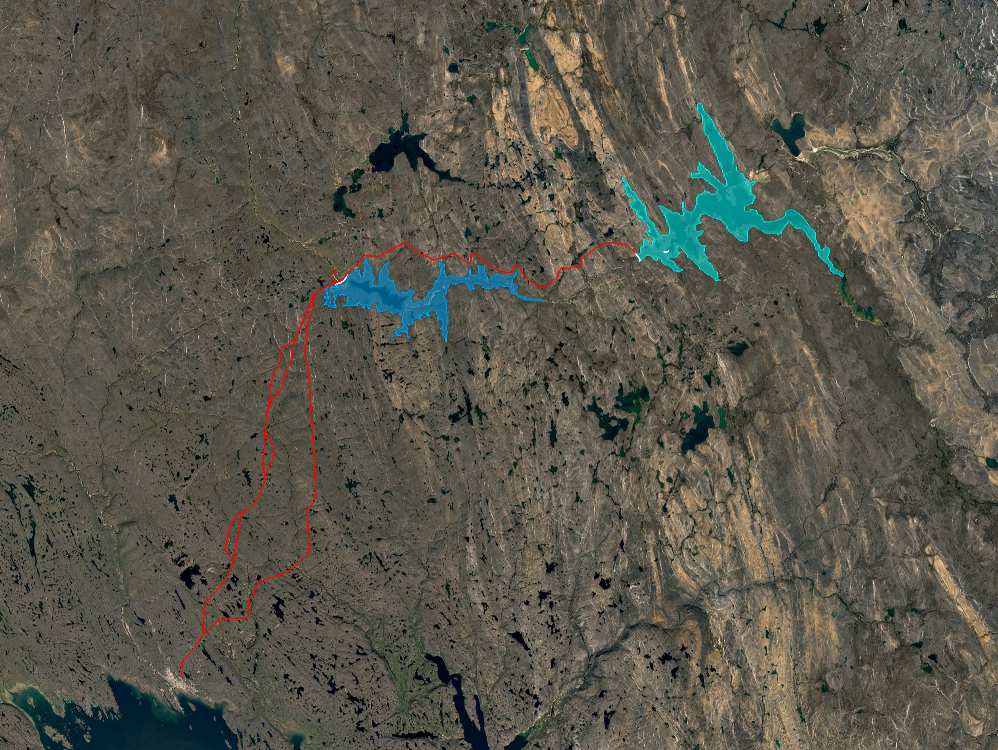


ᐃᒪᓐᓇ ᐋᕿᒋᐊᖅᓯᓚᐅᖅᑐᒍᑦ
HOW WE ADJUSTED
ᑕᖏᒃᓴᖓ ᐋᕿᒋᐊᖅᓯᒪᓕᖅᑐᖅ: ᐃᒪᑭᓐᓂᖅᓴᐅᓗᓂ ᐳᖅᑐᓂᖓ
ᐊᒃᑐᐃᓂᖓ: ᑕᐃᒪᓐᓇᐅᑐᐃᓐᓇᕆᐊᓕᒃ ᑖᓐᓇ 15 ᒥᒐ ᒍᐊᑦ ᒥᑭᓗᐊᖅᐸᑦ ᐊᑕᐅᓯᕐᒧᑦ ᐃᒪᐅᑎᖃᕐᕕᖓᓄᑦ
ᐋᕿᒋᐊᖅᑐᖅ: ᑎᑭᐅᑎᓇᓱᒃᓗᑕ 15 ᒥᒐ ᒍᐊᑦ ᐅᑯᐊᖑᔭᕆᐊᖃᕐᓕᐊᖅᑐᑦ:
  ᐃᓚᓗᒍ ᐱᖃᑖᓂᒃ ᐃᑲᔫᑎᓂᐊᖅᑐᒥᒃ ᐃᒪᖃᐅᑎᖃᕐᕕᒃᓴᖓᓂᒃᓗ ᐅᕝᕙᓘᓐᓃᑦ
  ᐃᓚᓗᒍ ᐊᓄᕆᒥᑦ ᐆᒻᒪᖁᑎᖃᐅᑎᒃᓴᒥᒃ
ᐃᒪᖓᓂ ᐊᐅᓚᐅᑎᖃᕐᕕᒃ ᐊᒻᒪᓗ ᓯᒥᖓ ᑰᒃ
Water Power Plant and Dam
ᑕᒪᐃᓐᓄᑦ ᐃᒥᖃᐅᑎᖃᕐᕕᖓ
Concept Revision: lower reservoir water level
Impact: It is a possibility that 15 MW cannot be achieved with a single reservoir
Adjustment: To achieve 15 MW may require:
  Adding a second supporting reservoir; or
  Adding wind power
Main Reservoir
ᐃᓯᕐᕕᐊᓄᑦ ᐊᖁᑎᑦ
Access Road
ᐱᑕᖃᕋᔭᖅᐸᑦ ᐃᑲᔫᑎᔪᒥᒃ ᐃᒥᖃᕐᕕᖓᓄᑦ
Potential Supporting Reservoir
ᐃᖃᓗᐃᑦ
ᐊᓄᕆᒃᑯᑦ ᐆᒻᒪᖁᑎᖃᐅᑎᖃᕆᐊᖃᕈᓂ ᐃᓂᒃᓴᖓ
Iqaluit
Potential Wind Power Site
12
Notes:
GREG SLIDE:
Because there is more gravel than we had anticipated during Phase 2 of the project, it may mean that the reservoir has to be smaller, meaning the water level can’t be as high as we had originally anticipated during Phase 2.
The impacts of this is that potentially, the water power plant may need additional support to achieve a capacity of 15 MW.
There are options for what this additional support might look like including adding a second reservoir upstream from the main reservoir, or it could also be achieved with adding wind power.
Jess Question: would the second reservoir have it’s own water power plant? (no, it would just have a dam – explain how it will increase the capacity!)
Jess Question: When will we know if a second reservoir or a wind farm might be needed? (there are still many unknowns and uncertainties about the project conditions which we still need to determine. Once we have more detailed information about the site conditions, we will have a better idea of additional support might be needed to achieve 15 MW.
Jess Question: Have you developed any concepts of the water power plant that you can show us? (The engineering team developed the first concept during Phase 2 and has continued to revise and improve this concept based on the information that has been gathered. Revisions ad adjustments is a normal part of the engineering process and there will still be many more to come. I’ll show you a video of where we are with concept development – play fly over video

