Slide 1
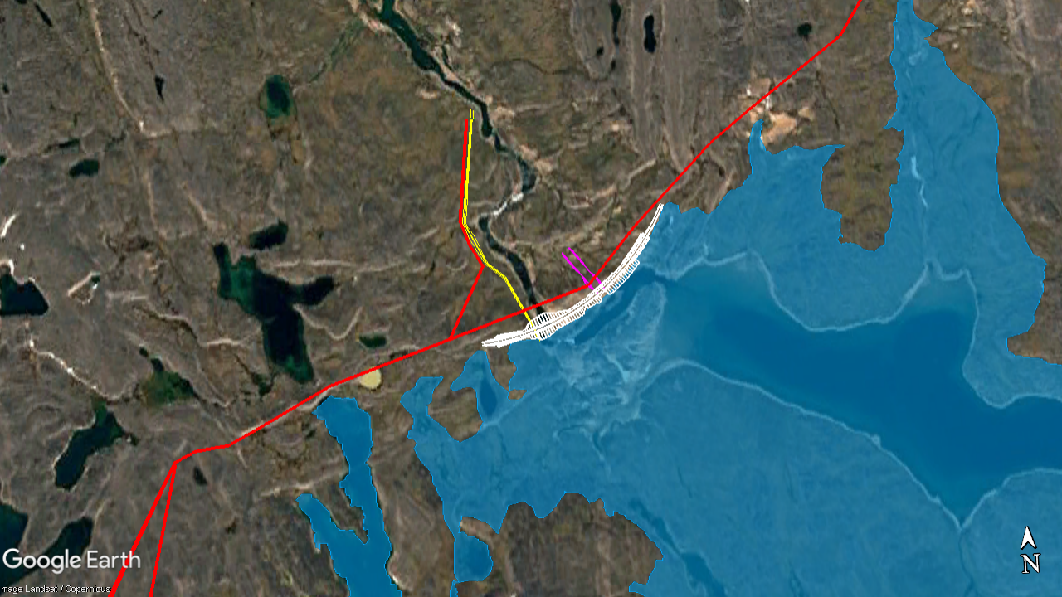
ᑕᖏᒃᓴᖓᑕ ᐱᕙᓪᓕᐊᑎᑕᐅᓂᖓ
CONCEPT DEVELOPMENT
ᐊᐅᓚᐅᑎᖃᕐᕕᒃ
ᐃᒡᓗᕋᓛᖅ
Powerhouse
ᑕᑕᓗᐊᕈᓂ ᑯᕕᔭᕆᐊᓕᒃ
Spillway
ᐊᖏᔪᐋᓗᒃ ᓱᓪᓗ
Penstock
ᑰᒃ ᓯᒥᒃᓯᒪᔪᖅ
Dam
ᐃᓯᕐᕕᐊᓄᑦ ᐊᖁᑎᑦ
Access Road
ᑕᒪᐃᓐᓄᑦ ᐃᒥᖃᐅᑎᖃᕐᕕᖓ
Main Reservoir
Notes:
GREG SLIDE:
Here is a closer up concept of the main reservoir and water power plant.
The reservoir is outlined and blue – a reservoir is a natural lake that has its water level raised to make the lake bigger.
The location of the dam is near the outlet of the lake (where the water leaves the lake to the river). The dam will be built higher than the natural water level of the lake and will slow down the water moving from the lake to the river. Because not as much water is now leaving the lake, it causes the water level in the lake to rise, creating the reservoir.
JESS QUESTION: So how does the water get through the dam to the river? (the dam will have an opening near the bottom of the dam– we call this the low level outlet – that allows some of the water to pass through to the river.)
JESS QUESTION: Can the fish move through this opening? (yes, exactly. Fish can still naturally swim from the lake to the river through this opening in the dam)
Another opening in the dam is for the penstock. The penstock is a large pipe that brings water to the part of the water power plant that will generate the electricity.
The powerhouse is where the electricity is produced. The powerhouse has turbines and a generator. Water moving through the penstock turns the turbines which then turn the generator to produce electricity. This electricity is then brought to Iqaluit through transmission lines.
JESS QUESTION: so for the penstock, how big and long will it be and will animals be able to pass over it to access the river? (the penstock will be buried so it will have no impact on the landscape. It will be about XX m in diameter and XX m long).
JESS QUESTION: back to the dam, at this point in your concept development, how will the dam be constructed? (speak to sheetpile, length, height, what it’s made of, etc).
JESS QEUSTION: so if the dam makes the lake water level higher, what happens in the spring time during snow melt and water levels are naturally higher? (The dam will have a spillway, this is a part of the dam that allows flood water to move over the dam in a safe and controlled way. All of this water then flows into the river. )
Greg: so this is where we are today with the water power plant concept development. There are still many things we need to do to better understand the site conditions to advance this concept into a preliminary design. Tetra Tech’s engineers are constantly adjusting the concept and thinking about different ways to make the water power plant as effective as possible. As we gather more information, we will be able to determine if this main reservoir is enough to meet the project’s target capacity, or if an additional reservoir or wind power is needed.

Slide 2
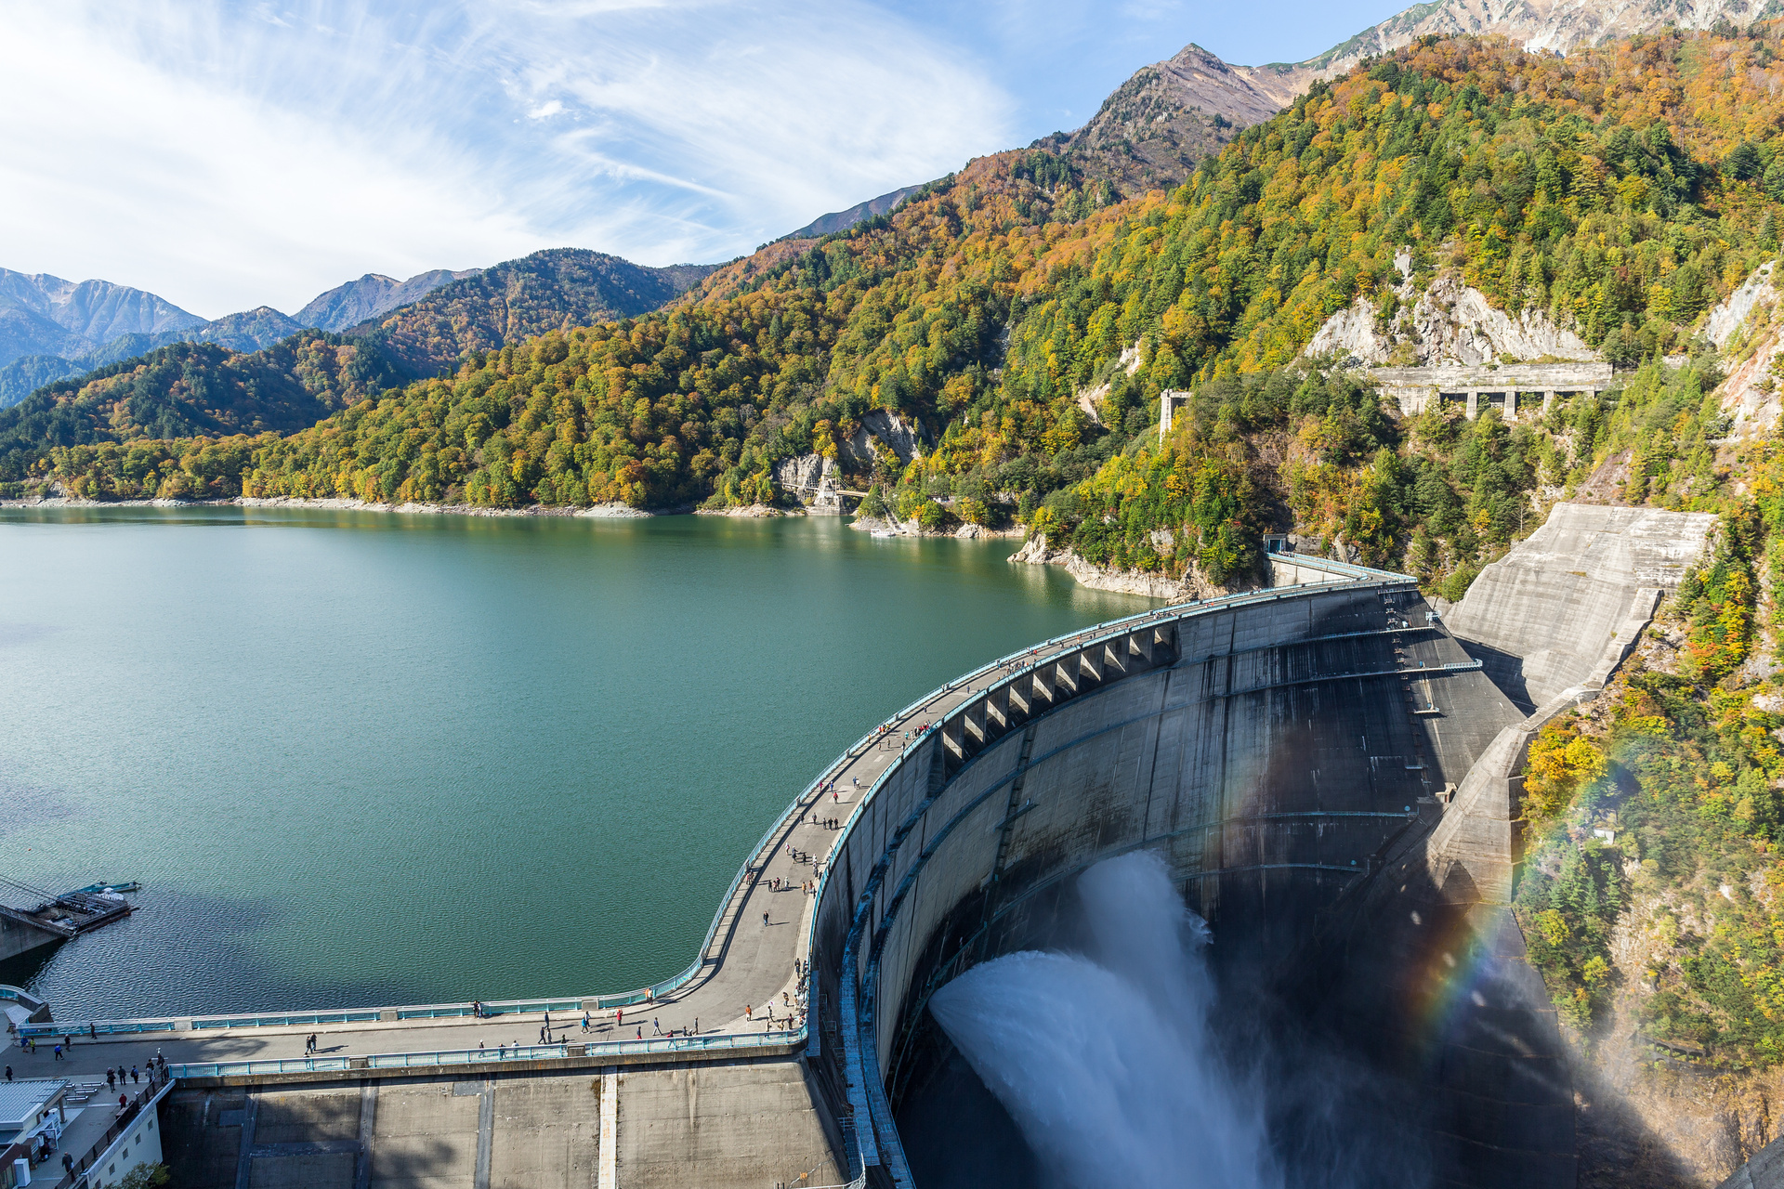
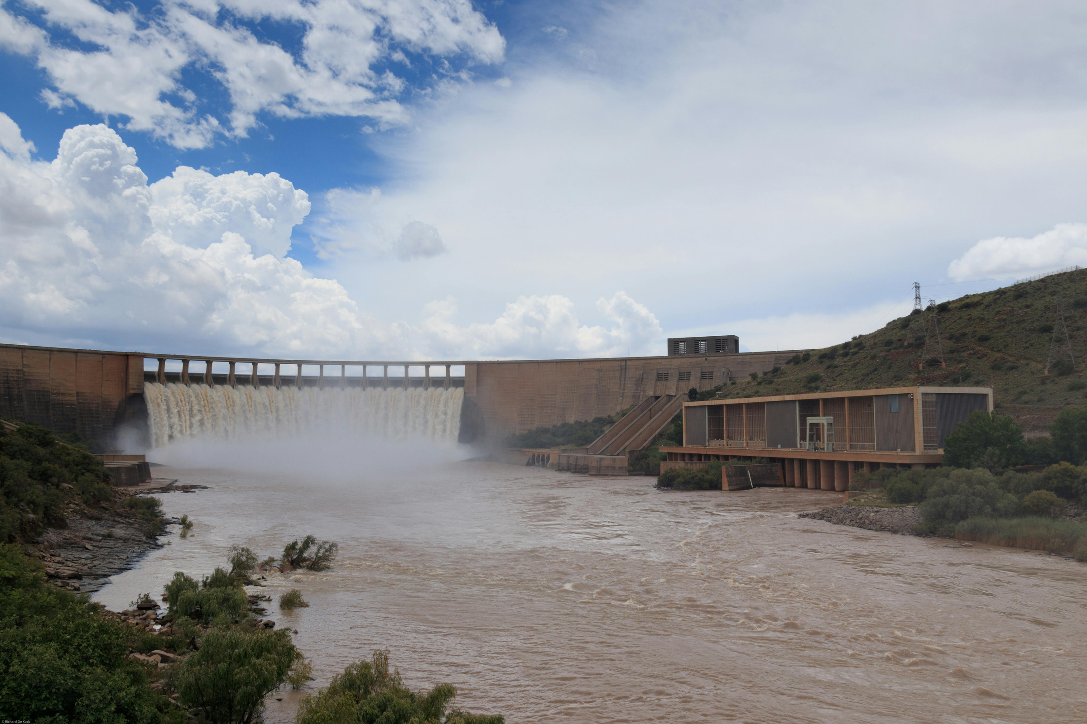
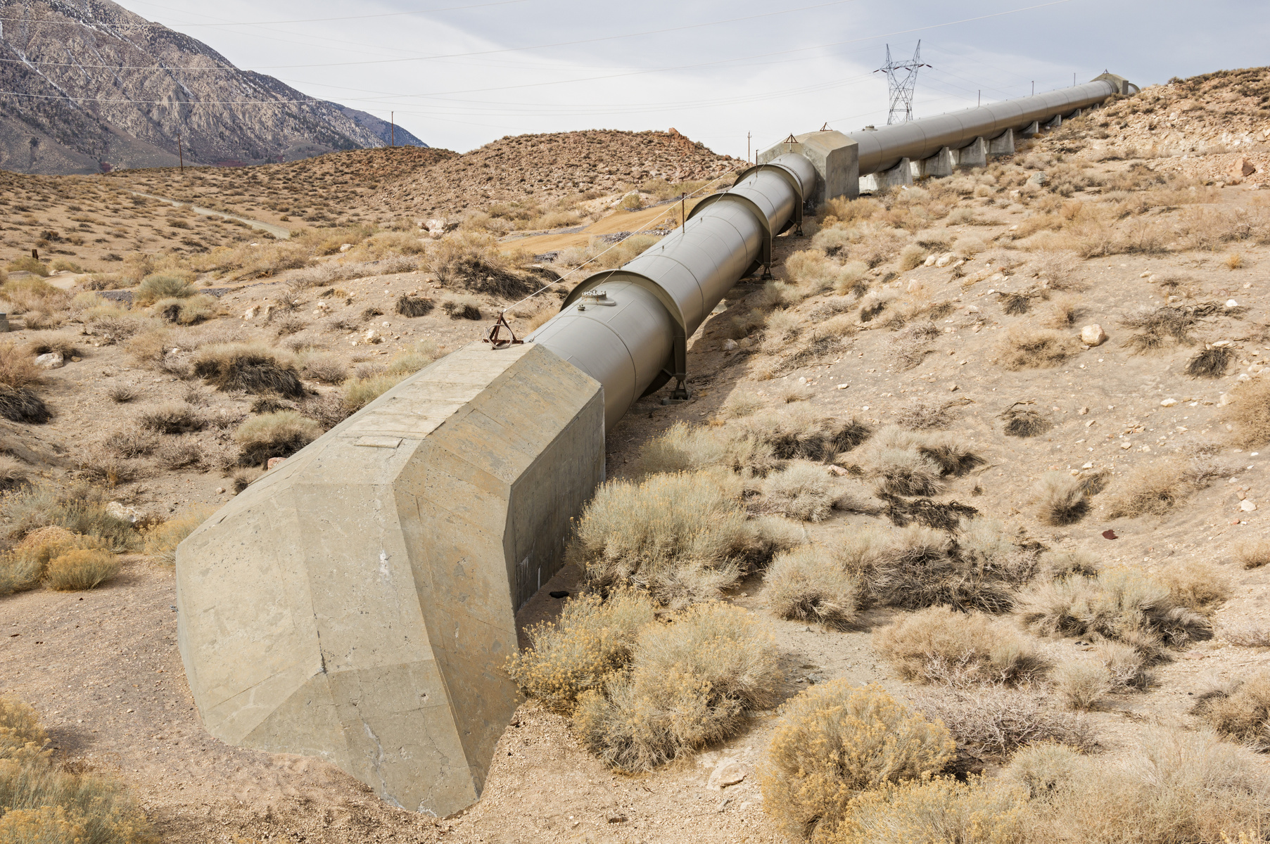
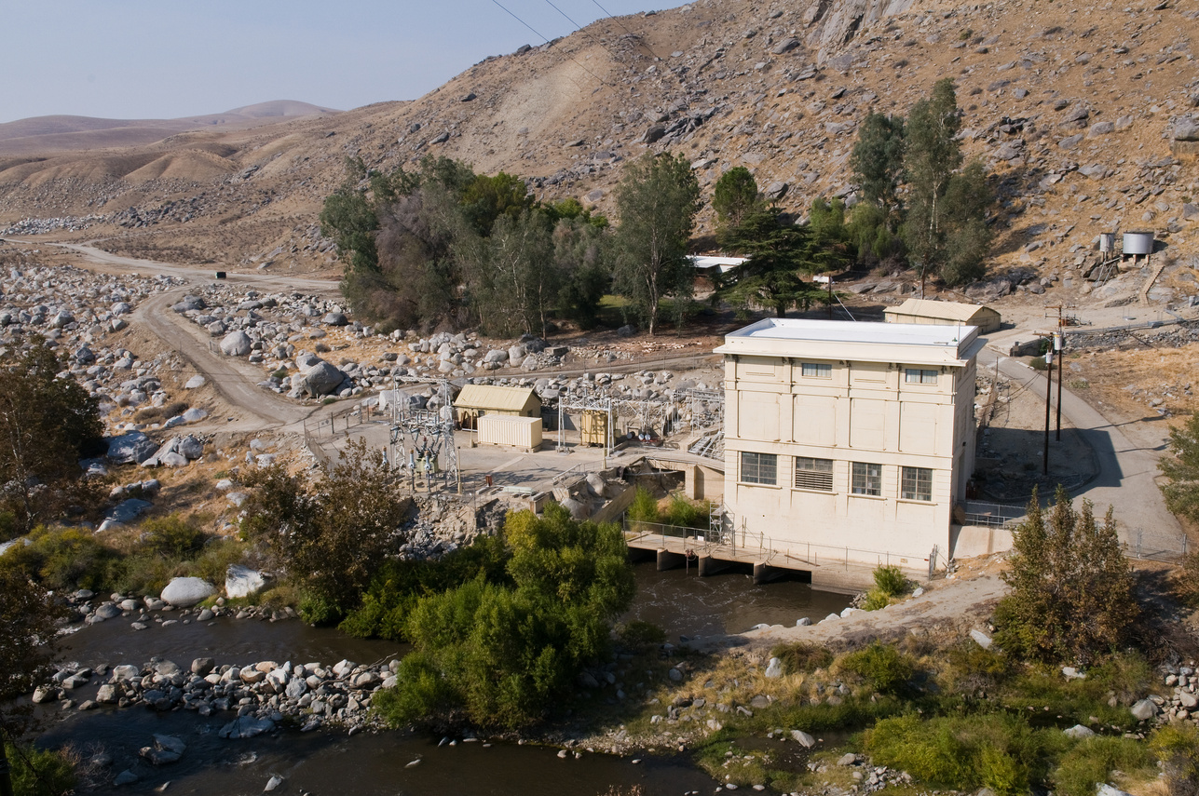

Slide 3

2025 ᑐᑭᓕᐅᕈᑕᐅᕙᓪᓕᐊᔪᑦ - ᐊᐅᓚᐅᓯᕆᓂᖓ
2025 OBJECTIVES – ENGINEERING
ᖃᓗᐃᓕᐅᕈᑕᐅᔪᑦ:
ᐃᓂᖓ ᐃᓕᑕᐅᓇᓱᒃᑐᖅ ᓲᕐᓗ ᒪᑯᐊ:
  ᐃᑦᑕᕐᓂᑕᖃᕐᕕᒃᓴᖃᕐᒪᖔ
  ᐊᕙᑎᖓ ᐃᓕᑕᐅᓇᓱᑦᑎᐊᕐᓗᓂ
  ᒪᓂᕋᖓ ᐋᕿᒃᓯᓯᒪᕕᐅᔪᓐᓴᕐᒪᖔᑦ ᖃᐅᔨᓴᖅᑕᐅᓗᓂ ᐊᒻᒪᓗ ᓄᓇᓐᖑᐊᓕᐅᕐᓗᑎᒃ ᐃᓂᖓᓂᒃ
ᐱᕚᓪᓕᕈᑎᒃᓴᑦ ᑕᖏᒃᓴᖏᑦ ᐱᒋᐊᖅᐸᓪᓕᐊᓕᓵᖅᑎᓪᓗᒍ ᓴᓇᓯᒪᓇᔭᕐᓂᖓ ᐊᒻᒪᓗ ᑐᑭᓕᐅᑦᑎᐊᕐᓗᒋᑦ ᐊᑭᖏᑦ ᐊᒻᒪᓗ ᐱᓕᕆᔭᐅᔪᓐᓇᕐᕕᒃᓴᖓᓄᑦ ᓇᓚᐅᑖᖅᓯᒪᔪᑦ
ᑲᔪᓯᔪᒥᒃ ᕿᓂᕐᓗᑎᒃ ᓴᓇᔭᐅᔪᒧᒃ ᑮᓇᐅᔭᒃᓴᓂᒃ
ᐱᓕᕆᖃᑎᒋᓗᒋᑦ ᖁᓪᓕᒃᑯᑦ ᐱᔭᕐᓂᓐᖏᑦᑐᓂᒃ ᐊᒻᒪᓗ ᖃᓄᐃᓕᐅᕆᐊᖃᖅᑐᓂᒃ ᓂᕆᒋᔭᖓᓐᓄᑦ
ᑐᑭᓕᐅᕈᑕᐅᕙᓪᓕᐊᔪᖅ: ᓄᐊᑦᑎᓗᓯ ᐊᒻᒪᓗ ᖃᐅᔨᓇᓱᒃᓗᓯ ᓄᓇᒥ ᖃᐅᔨᓴᖅᓯᒪᔪᓂᒃ ᑐᑭᓯᓗᒋᑦ ᖃᓄᖅ ᓴᓇᓯᒪᓂᖓ ᑐᑭᖃᑦᑎᐊᕋᔭᖅᐸ ᐃᖃᓗᐃᑦ ᐱᔪᒪᔭᖏᓐᓄᑦ:
  ᑖᓐᓇᑐᐊᖅ ᑕᒪᐃᓐᓄᑦ ᐃᒪᖃᐅᑎᖃᕐᕕᖓ?
  ᑕᒪᐃᓐᓄᑦ ᐃᒪᖃᐅᑎᖃᕐᕕᖓ + ᖁᓛᓂ ᐃᒪᖃᐅᑎᖃᕐᕕᖕᒥᑦ ᐃᑲᔪᖅᑕᐅᓗᓂ?
  ᑕᒪᐃᓐᓄᑦ ᐃᒪᖃᐅᑎᖃᕐᕕᖓ+ ᐃᓚᓗᒍ ᐊᓄᕆᒃᑯᑦ ᐆᒻᒪᖁᑎᖃᐅᑎᒃᓴᒥᒃ?
Activities:
Site studies and data collection such as:
  Archaeological survey
  Environmental studies
  Geotechnical investigation and topographic mapping
Advance concept to preliminary design and refine cost and capacity estimates
Continue to seek project funding
Engage QEC on logistical and technical expectations
Objective: Collect and analyze field data to understand what design makes most sense for Iqaluit's needs:
  Main reservoir only?
  Main reservoir + upper reservoir to support?
  Main reservoir + added wind energy?
Notes:
JESS/GREG SLIDE:
Perhaps Greg speak to technical field studies and Jess speak to Engagements/ regulatory etc.

Slide 4





2025 ᑐᑭᓕᐅᕈᑕᐅᕙᓪᓕᐊᔪᑦ - ᐱᓕᕆᖃᑎᒌᖕᓂᖅ
2025 OBJECTIVES - ENGAGEMENTS
ᐸᕐᓇᐃᓂᖅ ᓄᓇᒥ ᐊᕐᕌᒍ ᐃᓗᐊᓂ
2025 ᐱᓕᕆᖃᑎᒌᖕᓂᖅ:
ᐅᑭᐅᖅ :
  ᐅᖃᓪᓚᖃᑎᒌᒃᑕ ᐃᒪᕐᒥᑦ ᐆᒻᒪᖁᑎᖃᐅᑎᖃᕐᓂᖅ
  ᐃᓂᒋᔭᐅᔪᑦ ᐊᖁᑎᑦ ᐊᑕᔪᑦ
ᐅᐱᕐᖔᖅ : ᐃᖅᑲᓇᐃᔭᓕᕐᑎᑦᑎᓂᖅ ᐊᒻᒪᓗ ᑐᓴᕐᑎᑦᑎᓂᖅ ᓄᓇᒥ ᐊᕐᕌᒍ ᐃᓗᐊᓂ ᐸᕐᓇᐅᑎᓂᒃ
ᐊᐅᔭᖅ: ᐃᑭᐊᕿᕕᒃᑯᑦ ᑐᓴᕐᑎᑦᑎᓂᖅ ᖃᓄᐃᓕᖓᓕᕐᒪᖔᑕ ᓄᓇᒥᑦ
ᐅᑭᐊᒃᓵᖅ : ᑐᑭᓯᓇᖅᓯᔪᑦ ᑐᓴᖅᑎᑦᑎᔾᔪᑕᐅᓗᑎᒃ ᐊᒻᒪᓗ ᕿᒥᕐᕈᐊᖅᑕᐅᓗᑎᒃ
ᓯᕗᓂᐊᓂ ᖁᕕᐊᓱᒃᕕᒃ: ᓴᓇᔭᐅᔪᖅ ᐊᑎᒃᓴᖓ
ᑐᑭᓕᐅᕈᑕᐅᕙᓪᓕᐊᔪᖅ: ᑐᓂᓯᓯᒪᓗᑕ ᐊᕐᕌᒍ ᐃᓚᖓᓂ ᐱᓕᕆᖃᑎᒌᖕᓂᕐᒧᑦ ᐊᖏᖅᑕᐅᓯᒪᔪᑦ
Planning for the field season
ᑭᒃᑯᑐᐃᓐᓇᐃᑦ ᐃᓕᓐᓂᐊᖅᑎᓪᓗᒋᑦ
Public Education
ᐅᐱᕐᖓᒃᓵᖅ Early Spring
ᒫᑦᓯ-ᒪᐃ March-May
ᐃᖅᑲᓇᐃᔭᓕᕐᑎᑦᑎᓂᖅ ᐊᒻᒪᓗ ᑐᓴᕐᑎᑦᑎᓂᖅ ᓄᓇᒥ ᐊᕐᕌᒍ ᐃᓗᐊᓂ ᐸᕐᓇᐅᑎᓂᒃ
ᐅᑭᐅᖅ Winter
ᔮᓄᐊᕆ – ᕕᕗᐊᕆ Jan - Feb
ᐅᐱᕐᖔᖅ Spring
ᔫᓐ June
Hiring and sharing the field season plan
2025 Engagements:
Winter:
  Let’s Talk Water Power
  Trail systems
Spring: hiring and field season plan
Summer: online updates from the field
Fall: results sharing and review
Before Christmas: Project naming
Objective: deliver on seasonal engagement commitments
ᐅᑭᐊᒃᓵᖅ Fall
ᐅᒃᑑᐸ-ᓄᕕᐱᕆ Oct-Nov
ᐅᓂᒃᑳᕆᓗᒋᑦ ᑐᑭᓯᓇᖅᓯᔪᑦ ᓄᓇᒥ ᐊᕐᕌᒍ ᐃᓗᐊᓂ+ᖃᐅᔨᓴᖅᓯᒪᔪᑦ
ᐊᐅᔭᖅ Summer
ᔪᓚᐃ-ᓯᑎᐱᕆ July-Sept
ᐃᑭᐊᕿᕕᒃᑯᑦ ᑐᓴᕐᑎᑦᑎᓂᖅ ᖃᓄᐃᓕᖓᓕᕐᒪᖔᑕ ᓄᓇᒥᑦ
Reporting on the results of the field season + analysis
Online updates from the field
Notes:
JESS SLIDE:
Spring: hiring and plan sharing
Summer: online updates from the field
Fall: results sharing and review
Before Christmas: Project naming

Slide 5




2025 ᑐᑭᓕᐅᕈᑕᐅᕙᓪᓕᐊᔪᑦ - ᓴᓇᔭᐅᔪᓐᓇᖅᑐᑦ ᓂᕈᐊᖑᓯᒪᔪᓐᓇᖅᑐᑦᑕᐅᖅ
2025 OBJECTIVES – ADDITIONAL PROJECT OPTIONS
ᐃᓂᒃᓴᖓᓂᑦ
15 ᒥᒐᒍᐊᑦ ᐊᐅᓚᐅᑎᖃᐅᑎ ᓄᒃᑭᒃᓴᐅᑎ ᑎᑭᐅᒪᔪᑦ 100% ᐃᖃᓗᖕᒥᐅᑦ ᐆᒻᒪᖁᑎᖃᐅᑎᖃᕆᐊᖃᖅᑕᖏᓐᓄᑦ
ᓂᕈᐊᖅᑕᐅᓯᒪᔪᓐᓇᕐᒥᔪᖅ 1
100% ᐃᖃᓗᖕᒥᐅᑦ ᐆᒻᒪᖁᑎᖃᐅᑎᖃᕆᐊᖃᖅᑕᖏᓐᓄᑦ
+
ᐅᖂᓴᕈᑎᒃᓴᓄᑦ ᑭᓐᖒᒪᓇᖅᑐᓄᑦ
ᓂᕈᐊᖅᑕᐅᓯᒪᔪᓐᓇᕐᒥᔪᖅ 2
100% ᐃᖃᓗᖕᒥᐅᑦ ᐆᒻᒪᖁᑎᖃᐅᑎᖃᕆᐊᖃᖅᑕᖏᓐᓄᑦ
+
ᐃᑲᔫᑎᔪᖅ ᑲᒻᐸᓂᐅᔪᓂᑦ ᐊᑐᖅᑕᐅᓂᐊᖅᑐᖅ
Base case
15MW power generation to meet 100% Iqalungmiut’s electricity needs
Additional Option 1
100% Iqalungmiut’s electricity needs
+
heating needs
Additional Option 2
100% Iqalungmiut’s electricity needs
+
off-site industrial users
ᑐᑭᓕᐅᕈᑕᐅᕙᓪᓕᐊᔪᖅ: ᑐᑭᓯᓗᒋᑦ ᐃᖃᓗᖕᒥᐅᑦ ᐱᔪᒪᔭᖏᑦ ᖃᓄᖅ ᐊᖏᓂᒋᓂᐊᕐᒪᖔᑦ ᓴᓇ ᐅᔪᖅ
Objective: Understand Iqalungmiut desire for how big this Project should be
Notes:
JESS SLIDE – speak to what each additional option would mean (changing to electric heat, etc)
The current project concept assumes the project will produce clean energy to meet Iqaluit’s current and future electricity demand. We consider this the base scenario.
In addition to the base scenario, NNC is considering investigating two additional opportunities:
Additional Option 1: produce additional clean energy for Iqaluit's heating demand. This would require homes and buildings to transition to electric heating methods.
Additional Option 2: produce additional clean energy for off-site industrial electricity demand, such as a future mine near Iqaluit.
There are still many unanswered questions about the additional options which will have to be investigated to determine if they are feasible.
NNC’s exploration of Alternative 1 would include answering questions such as:
How would homes and buildings be converted to electric heat?
Who would pay for this?
Would electric heat be less expensive?
How would this affect the Project scope and cost?
Would this impact the environment and the community differently from the base case?
NNC’s exploration of Alternative 2 would include answering questions such as:
What future industrial demand can we expect?
How would this affect the Project scope and cost?
Would this impact the environment and the community differently from the base case?

Slide 6
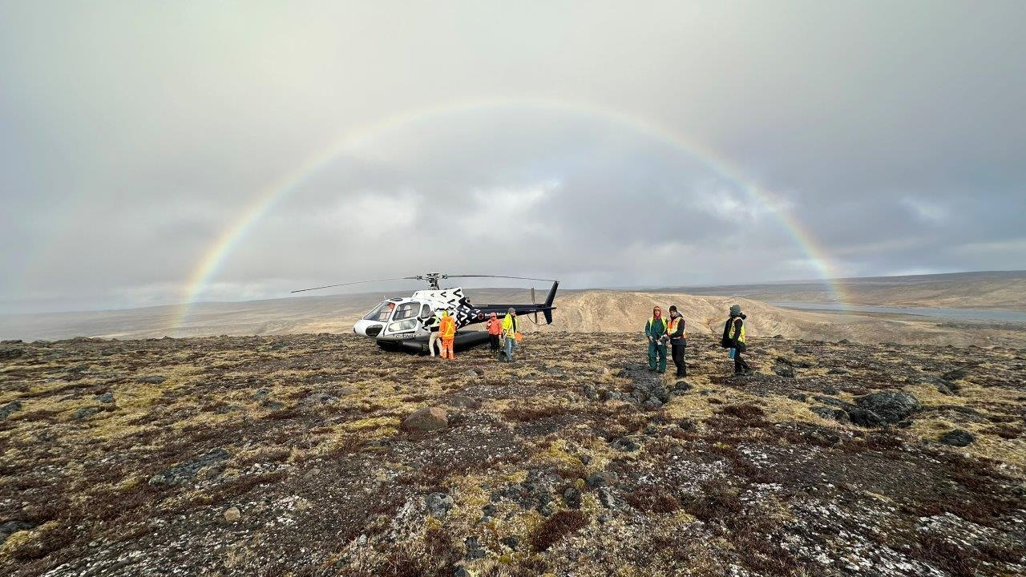
ᓂᐲᑦ ᐅᖃᐅᓯᒃᓴᑎᑦ ᑐᓴᖅᑕᐅᑎᓪᓗᒋᑦ
MAKE YOUR VOICE HEARD
ᖃᐃᖁᔨᕗᒍᑦ ᐃᓕᖕᓂᒃ ᐱᔭᕇᖅᓯᓂᐊᕋᕕᑦ ᖃᐅᔨᓴᕈᑎᒥᒃ ᖃᐅᔨᑎᑦᑎᓂᐊᕋᕕᑦ ᐃᑲᔪᕐᒪᖔᖅᐱᑦ ᖃᐅᔨᓴᖅᑕᐅᔪᓂᒃ ᐊᑕᐅᓯᕐᒥᒃ ᐅᕝᕙᓘᓐᓃᑦ ᑕᒪᕐᒥᒃ ᖄᖓᒍᑦ ᓂᕈᐊᖅᑕᐅᓯᒪᔪᓐᓇᖅᑐᓂᒃ. ᐅᓇ ᖃᐅᔨᓴᕈᑎ ᐊᐱᖅᓲᑎᑦᑎᒍᑦ ᐱᕕᖃᕐᑎᑦᑎᖕᒥᔪᑦ ᑭᐅᓯᔪᓐᓇᕐᓗᑎᑦ ᐅᓪᓗᒥ ᖃᓄᐃᓕᐅᕈᑕᐅᔪᓂᒃ ᐊᒻᒪᓗ ᓴᓇᔭᐅᔪᒥᒃ.
We invite you to complete the survey to let us know if you support investigation of one or both additional options. The survey is also a chance to provide feedback on today’s event and the Project.
ᒪᑐᐃᕈᓐᓇᖅᑕᐃᑦᑕᐅᖅ ᐅᓇ www.nunavutcleanenergy.ca ᑭᐅᓯᕕᒋᓗᒍ ᐊᐱᖁᑎᑦ ᖃᐅᔨᓴᕈᑎᑦ ᐃᑭᐊᕿᕕᒃᑯᑦ.
You can also visit www.nunavutcleanenergy.ca to answer the survey online.
Notes:
JESS SLIDE:
I think we need to speak to how people’s questions will be answered on the survey!
Please either answer on this paper and place it in the box or take a stamped envelope and send it to us in the mail. You can also go to our website to answer the survey online at www.nunavutcleanenergy.ca

Slide 7
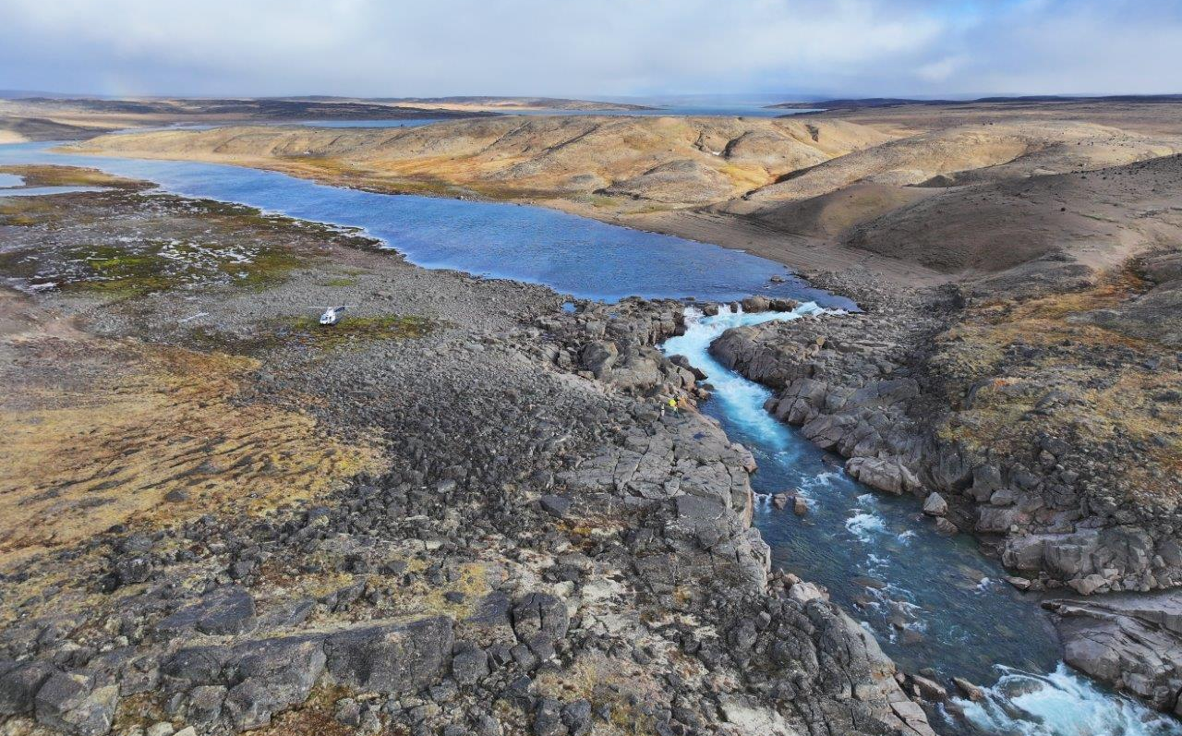




ᖁᔭᓐᓇᒦᒃ
THANK YOU
www.nunavutcleanenergy.ca
NNC@QCORP.CA
(867) 979-8400

