Slide 1

ᑲᖏᖅᑐᒑᐱᒃ
ᓄᑖᖅ ᐃᒥᕐᒧᑦ ᓴᓗᒻᒪᖅᓴᐃᕕᒃ −
ᕼᐋᒻᒪᓚᒃᑯᑦ ᑲᑎᒪᔨᖏᓐᓄᑦ ᐅᓂᒃᑲᐅᓯᖅ 2024
Clyde River
New Water Treatment Plant -
Council Presentation October 2024

Slide 2
ᑲᑎᒪᔾᔪᑎᒃᓴᑦ
Agenda
ᐱᓕᕆᐊᒃᓴᕆᔭᐅᔪᖅ ᐅᓂᒃᑲᐅᓯᐅᓂᖓ ᑐᕌᒐᕆᔭᐅᔪᒧᑦ
ᐱᓕᕆᐊᒃᓴᖅ ᓇᓗᓇᐃᖅᓯᒪᔪᖅ
ᖃᖓᑦᑎᐊᓕᓴᑦ ᐊᔾᔨᐸᓗᖏᑦ ᐱᓕᕆᐊᒃᓴᑦ
ᐃᕐᕈᖅᑐᐃᔾᔪᑎ ᐃᒪᑦᑎᐊᕙᓕᐅᕈᑦ
ᐱᓕᕆᐊᖑᔫᑉ ᖃᖓᒃᑰᕐᕕᒃᓴᖏᑦ
ᐊᐱᖅᑯᑎᒃᓴᐃᑦ?
Business Case Objectives
Project Overview
Recent Similar Projects
Treatment System
Project Timelines
Questions?

Slide 3
ᐱᓕᕆᐊᒃᓴᕆᔭᐅᔪᖅ ᐅᓂᒃᑲᐅᓯᐅᓂᖓ ᑐᕌᒐᕆᔭᐅᔪᒧᑦ
Business Case Objectives
ᐋᖅᑭᒃᓱᐃᔪᖃᕐᓗᓂ ᑕᐅᑦᑐᒃᓴᖓᓂᒃ ᑕᐅᑦᑐᒃᓴᓕᐅᖅᑕᐅᓂᐊᖅᑐᒥᒃ ᓄᑖᒧᑦ ᐃᒪᕐᒧᑦ ᓴᓗᒻᒪᖅᓴᐃᕝᕕᖕᒧᑦ ᐊᖑᒻᒪᑎᔪᒥᒃ ᑲᓇᑕᒥᐅᓄᑦ ᐃᒪᑦᑎᐊᕙᖕᒧᑦ ᒪᓕᒃᑕᐅᔭᕆᐊᖃᖅᐸᒃᑐᓂᒃ.
ᓇᓗᓇᐃᕐᓗᒍᑦ ᓯᕗᓂᒃᓴᒥ ᐃᒪᖅᑖᕐᕕᒃᓴᖅ ᐊᑐᐃᓐᓇᐅᓂᖓ ᐃᓄᒋᐊᒃᓯᕙᓪᓕᐊᔪᓪᓗ 2050-ᒧᑦ ᑎᑭᓪᓗᒍ
ᓇᓗᓇᐃᖅᓯᒪᔪᑦ ᐋᖅᑭᒃᓯᒪᓂᒃᓴᖓᓄᑦ ᐱᔭᐅᔭᕆᐊᓖᑦ ᐃᓱᒪᒋᔭᐅᓪᓗᑎᒃ ᐊᐅᓚᒐᕐᓂᖅᑐᑦ ᐊᒻᒪ ᐅᖓᓯᒋᔭᐅᓗᓂ ᖃᐅᔨᓴᖅᑕᐅᕗᓐᓇᕋᔭᕐᓂᖓ
ᐱᔭᕇᕐᓗᒋᑦ ᐱᓕᕆᐊᖑᖃᑦᑕᖅᓯᒪᔪᑦ ᖃᐅᔨᓴᖅᑕᐅᖃᑦᑕᖅᓯᒪᔪᑦ ᐃᑲᔪᖅᓱᕐᓗᒋᑦ ᓇᓗᓇᐃᖅᓯᒪᔪᑦ ᐋᖅᑭᒃᓯᒪᓂᒃᓴᖏᑦ ᐃᒪᕐᒧᑦ ᓴᓗᒻᒪᖅᓴᐃᕕᖕᒧᑦ
Develop a schematic design for a new water treatment plant that meets Canadian Drinking Water Quality Guidelines.
Confirm future source water security and availability for growing population until 2050
Outline design requirements with consideration for ease of operation & remote monitoring
Complete background studies to support the detailed design of the Water Treatment Plant

Slide 4
ᐱᓕᕆᐊᒃᓴᖅ ᓇᓗᓇᐃᖅᓯᒪᔪᖅ
Project Overview
ᑎᓚᓐ ᐱᔨᑦᑎᕋᖅᑎᖏᑦ ᓯᕗᓪᓕᖅᐹᖅᓯᐅᑎᒥᒃ ᐸᕐᓇᐅᑎᓕᐅᖁᔭᐅᓚᐅᖅᑐᑦ ᐃᒪᓕᕆᕝᕕᒃᓴᒥᒃ ᐊᒻᒪ ᐱᕈᖅᑎᑦᑎᓗᑎᒃ ᐱᓕᕆᐊᒃᓴᐅᓂᖓᓄᑦ ᓇᓗᓇᐃᔭᖅᓯᔾᔪᑎᒥᒃ
ᑖᓐᓇ ᓯᕗᓪᓕᖅᐹᖅᓯᐅᑎᒧᑦ ᐱᒋᐊᕈᑕᐅᓂᖓ ᐃᓚᖃᖅᑐᖅ:
  ᓇᓗᓇᐃᖅᓯᓂᖅ ᓄᓇᐅᑉ ᖃᓄᐃᓕᖓᓂᖓᓂᒃ ᑕᐅᑦᑐᒃᓴᖓᓄᑦ ᐸᕐᓇᓕᕈᓂ
  ᖃᓄᖅ ᓴᓇᓯᒪᓇᔭᕐᓂᖓᓄᑦ ᑎᑎᕋᐅᔭᕐᓗᓂ ᖃᔅᓯᓂᒃ ᓇᓪᓕᕌᒐᒃᓴᓂᒃ
  ᐱᕙᒌᔭᕐᓗᒍ ᐊᑐᔅᓲᔭᕈᓐᓇᕐᓂᖓᓄᑦ ᐊᑭᖓᑕ ᒥᒃᓴᐅᓯᖅᑕᐅᓇᔭᕐᓂᖏᓐᓂᒃ
ᓄᑖᖅ ᐃᒪᓕᕆᕝᕕᒃ ᒪᓕᖕᓂᐊᖅᑐᖅ ᒐᕙᒪᑐᖃᒃᑯᑦ ᒪᓕᒋᐊᓕᖏᓐᓂᒃ ᐊᒻᒪ ᓄᓇᕗᒻᒥ ᐊᑐᐊᒐᕐᓂᒃ
Dillon Consulting was hired to carry out the preliminary planning for the new Water Treatment Plant and to develop a supporting Business Case
This preliminary work includes:
  Determining the site characteristics for the design
  Developing schematic design options
  Preparing a lifecycle cost estimate
New facility will meet Federal Guidelines and Territorial Regulations

Slide 5
ᐱᓕᕆᐊᒃᓴᖅ ᓇᓗᓇᐃᖅᓯᒪᔪᖅ
Project Overview
ᓇᓗᓇᐃᖅᑕᐅᓯᒪᔪᑦ ᐱᓕᕆᐊᒃᓴᑦ ᐅᑯᓂᖓ ᐃᓚᖃᖅᐳᑦ:
      ᓇᓗᓇᐃᖅᑕᐅᓂᖓ ᐃᓂᐅᔪᒥᑦ ᖃᓄᐃᓕᖓᓂᖏᑦ (ᓄᓇᐅᑉ ᖃᓄᐃᑦᑑᓂᖓ, ᐊᕙᑎᓕᕆᓂᖅ, ᐃᑦᑕᕐᓂᓴᓕᕆᓂᖅ ᐊᓯᖏᓪᓗ)
      ᐃᒪᕐᒥᒃ ᖃᐅᔨᓴᕐᓂᖅ ᒫᓐᓇ ᐃᒥᖅᑖᕐᕕᐅᓲᒥ ᐃᑎᓂᖓ ᐊᑯᓂᐅᔪᒧᑦ ᓈᒻᒪᖕᒪᖔᖅ
      ᖃᐅᔨᒪᓕᕐᓗᒋᑦ ᐋᖅᑭᒃᓯᒪᓂᒃᓴᖓᓄᑦ ᐱᔭᐅᔭᕆᐊᓖᑦ ᐃᒪᕐᒧᑦ ᓴᓗᒻᒪᖅᓴᐃᕕᖕᒧᑦ
      ᓇᓕᖅᑳᒐᒃᓴᓂᒃ ᓴᓗᒻᒪᖅᓴᐅᑎᓂᒃ ᓇᓗᓇᐃᕐᓗᒋᑦ ᓇᓕᐊᒡᓗ ᐊᑐᓕᖁᔭᐅᔪᖅ ᖃᓄᐃᓕᐅᕈᑕᐅᔭᕆᐊᖃᕐᒪᖔᖅ
      ᐋᖅᑭᒃᓯᓗᓂ ᐊᑭᑐᔫᑎᓄᑦ ᑮᓇᐅᔭᖃᖅᑎᑕᐅᔾᔪᑎᒃᓴᓂᒃ ᑐᒃᓯᕋᐅᑎᒥᒃ
Specific tasks for the project include:
      Confirmation of Site Conditions (Geotechnical, Environmental, Archeological etc. )
      Hydrology study on the existing water source to determine its long-term water security
      Determine the design requirements for the Water Treatment Plant
      Develop treatment options and recommend an approach
      Develop a cost estimate for the capital funding request

Slide 6
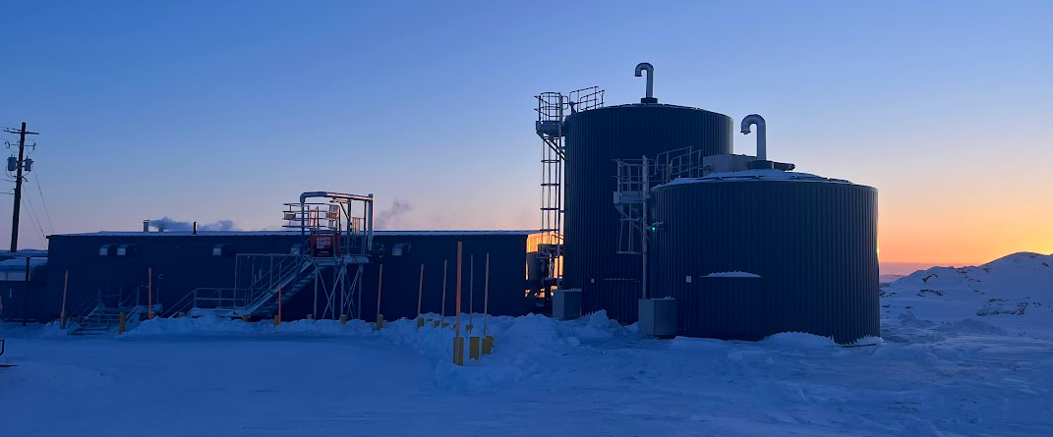
ᖃᖓᑦᑎᐊᓕᓴᑦ ᐊᔾᔨᐸᓗᖏᑦ ᐱᓕᕆᐊᒃᓴᑦ
Recent Similar Projects
ᖃᔅᓯᑲᓪᓚᐃᑦ ᓄᓇᓖᑦ ᓴᓇᔭᐅᓯᒪᕗᑦ ᐱᕙᒌᔭᖅᑕᐅᓂᐊᖅᐳᓪᓘᓐᓃᑦ ᓴᓇᔭᐅᔪᒪᓪᓗᑎᒃ ᐊᑐᖅᑐᖃᕐᓗᓂ ᐊᔾᔨᑲᓴᖏᓐᓂᒃ ᑲᔪᓯᐊᔾᔪᑕᐅᕙᒃᑐᓂᒃ:
ᑎᑭᕋᕐᔪᐊᖅ – ᓴᓇᔭᐅᔪᖅ
ᐊᐅᓱᐃᑦᑐᖅ − ᐸᕐᓇᒃᑕᐅᔪᖅ ᓴᓇᔭᐅᓯᒋᐊᓛᖅᖢᓂ 2025−ᒥ
ᐃᒃᐱᐊᕐᔪᒃ − ᐸᕐᓇᒃᑕᐅᔪᖅ ᓴᓇᔭᐅᓯᒋᐊᓛᖅᖢᓂ 2025−ᒥ
Several communities are constructed or plan to be constructed using similar processes:
Whale Cove– Constructed
Grise Fiord – Planned for construction to start 2025
Arctic Bay – Planned for construction to start 2025
ᑎᑭᕋᕐᔪᐊᖅ
Whale Cove

Slide 7
ᐃᕐᕈᖅᑐᐃᔾᔪᑎ
ᐃᒪᑦᑎᐊᕙᓕᐅᕈᑦ
Treatment System
ᐃᒪᓕᕆᕝᕕᒃ ᑲᓇᑕᒥ ᐃᒪᑦᑎᐊᕙᓕᕆᓂᕐᒧᑦ ᒪᓕᒋᐊᓕᒃ ᑲᓇᑕᒥᐅᓕᒫᑦ ᐃᒪᑦᑎᐊᕙᖃᕆᐊᖃᕐᓂᖏᓐᓄᑦ
ᓄᓇᕗᒻᒥ ᒪᓕᒃᑕᐅᒋᐊᖃᖅᑐᖅ ᐃᒪᕐᒧᑦ ᓴᓗᒻᒪᖅᓴᐃᕕᒃ ᖃᐅᔨᓴᖅᑕᐅᓂᐊᖅᑐᖅ ᑲᖏᖅᑐᒑᐱᖕᒥᐅᑦ ᖃᐅᔨᒪᔭᒥᓂᒃ ᑐᓴᖅᑎᑦᑎᓗᑎᒃ ᐊᔾᔨᐸᓗᖏᓐᓂᒃ ᐱᓕᕆᔾᔪᑎᓕᖕᓂᒃ.
ᓄᓇᕗᒻᒥ ᒪᓕᒃᑕᐅᒋᐊᖃᖅᑐᖅ ᐃᒪᕐᒧᑦ ᓴᓗᒻᒪᖅᓴᐃᕝᕕᖕᓄᑦ ᐱᓕᕆᐊᖑᓪᓗᐊᑕᖅᐸᒃᑐᑦ: ᖃᐅᔨᓴᖅᓯᓂᖅ, ᐱᕈᖅᑐᓂᒃ ᐲᔭᐃᓂᖅ, ᓱᕈᐃᔭᐃᓂᖅ, ᐊᒻᒪᓗ ᐃᕐᕈᖅᑐᐃᔾᔪᑎᓕᖅᓯᓂᖅ + ᓯᕿᓂᐅᑉ ᖃᐅᒪᖓᓂᒃ/ᐆᓇᕐᓂᖓᓂᒃ ᖁᐱᕐᕈᐃᔭᐃᓂᖅ
Water treatment to achieve Health Canada's Guidelines for Canadian Drinking Water Quality
Nunavut’s Standard Water Treatment Train (SWTT) will be evaluated as an option for Clyde River to have shared knowledge between communities with similar equipment.
SWTT Core processes: screening, organics removal, filtration, and chlorine + Ultraviolet light disinfection

Slide 8
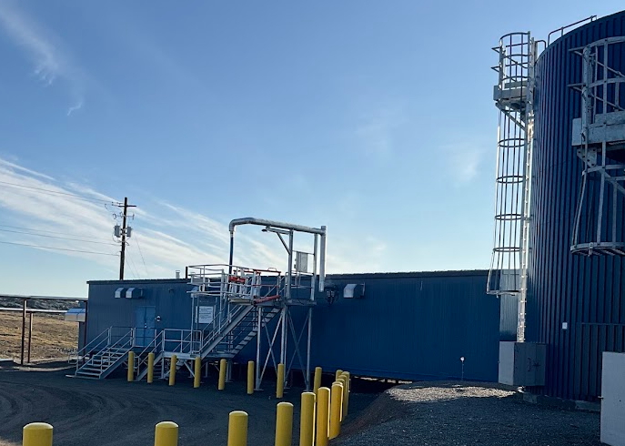
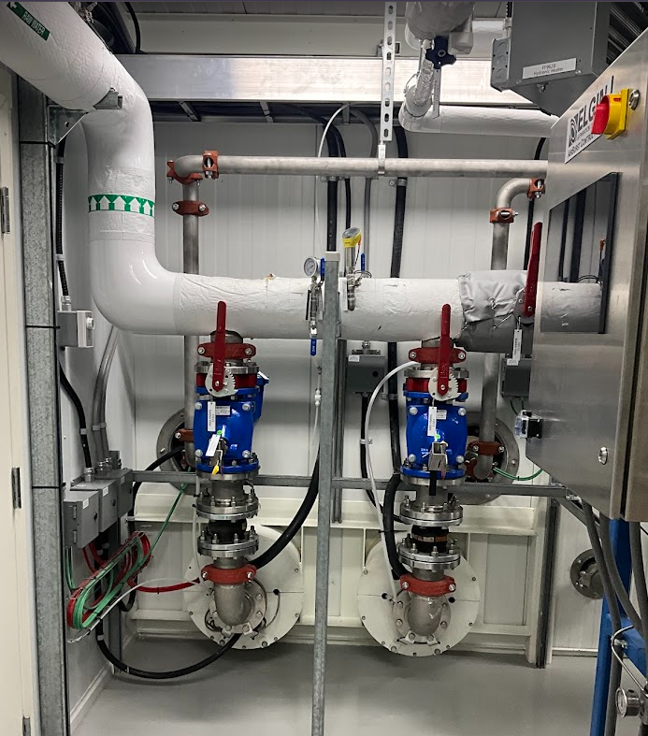
ᐃᒥᕐᒥᑦ ᓴᓗᒪᖅᓴᐃᕕᐅᑉ ᐋᖅᑭᑦᓯᒪᓂᖓ
Water Treatment Plant Design
  ᐊᑕᐅᓰᓐᓇᓕᓂᖅ ᐊᒻᒪ ᐊᓯᔾᔨᕈᓐᓇᕐᓂᖅ ᐱᒻᒪᕆᐅᔪᑦ
  1-2 ᐅᓪᓗᐃᑦ ᐃᒪᑦᑎᐊᕙᒃ ᐅᑕᖅᑭᓕᖅᑐᖅ, 20−ᒥᓂᑦ ᐅᑕᖅᑭᖃᑦᑕᖅᖢᑎᒃ ᐃᒥᖅᑕᖅᑎᓂᒃ ᐃᒻᒥᖅᓯᙱᓐᓂᕐᒥᓂᒃ
  ᓴᓇᓯᒪᔪᖅ ᓯᕗᓂᒃᓴᖓ ᓄᓇᓕᐅᑉ ᐱᕈᕐᓂᒃᓴᖓ ᐃᓄᒋᐊᒃᓯᕙᓪᓕᐊᓂᒃᑯᑦ ᒪᓕᒃᑕᐅᓪᓗᓂ
  ᐃᑭᑦᑐᒧᑦ ᑯᕕᔪᖅ ᖄᖐᓪᓗᓂ ᐃᒪᕐᒧᑦ ᓴᓗᒻᒪᖅᓴᐃᕝᕕᒃ ᑐᐊᕕᕐᓇᖅᑐᖃᓕᖅᐸᑦ
  Redundancy and flexibility are key items
  1-2 days of treated water storage, removing 20-minute hold times for water trucks
  Designed for the future community size
  Fire flow bypass of the water treatment plant for emergencies

Slide 9
ᓂᕆᐅᒋᔭᐅᔪᖅ ᐱᓕᕆᐊᖑᔪᖅ
ᖃᖓᒃᑰᖃᑦᑕᕐᕕᒃᓴᖏᑦ
Anticipated Project
Timelines
ᐱᓕᕆᐊᒃᓴᕆᔭᐅᔪᖅ ᐱᔭᕇᖅᑕᐅᓂᐊᕋᓱᒋᔭᐅᔪᖅ ᐅᑐᐱᕆ 2025
ᓯᕗᓂᒃᓴᒥ ᐱᓕᕆᐊᖑᓕᖅᐸᑦ ᐊᒡᒍᖅᓯᒪᓂᒃᓴᖏᑦ (ᑮᓇᐅᔭᖃᖅᑎᑕᐅᒍᑎᒃ):
ᒪᓕᒐᖅᑎᒍᑦ ᐊᖏᖅᑕᐅᔪᑦ
ᓇᓗᓇᐃᔭᖅᓯᒪᔪᖅ ᑕᐅᑦᑐᒃᓴᖓ
ᓴᓇᔭᐅᓂᖓ
Business Case is expected to be completed October 2025
Future Phases (subject to funding):
Regulatory Approvals
Detailed Design
Construction

Slide 10
ᐊᐱᖅᑯᑏᑦ?
Questions?

