Slide 1
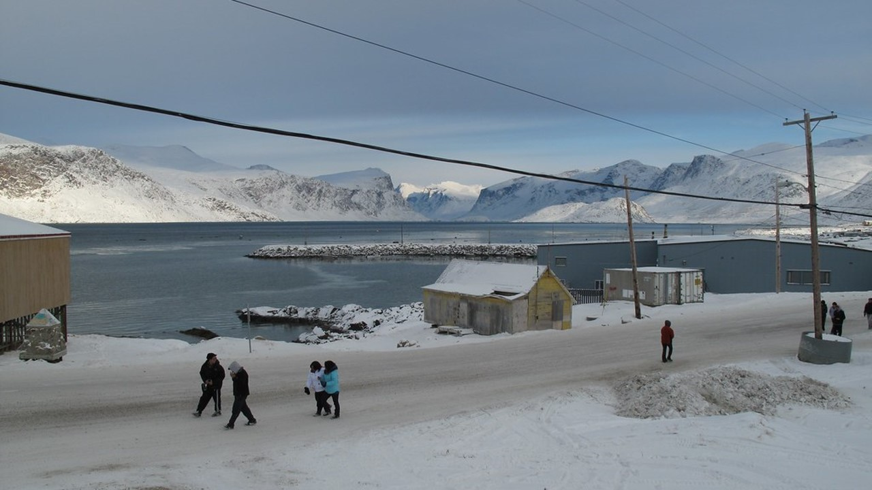


ᐅᖅᓱᖅᑑᖅ – ᓄᑖᖅ ᐃᒪᖃᐅᑎᖃᕐᕕᒃᓴᖓ Gjoa Haven – New Water Treatment Plant
ᑲᑎᒪᔨᓄᑦ ᐅᖃᐅᑎᒃᓴᖅ
Council Presentation
ᓯᑎᐱᕆ 2025
September 2025

Slide 2

ᐅᖅᓱᖅᑑᖅ – ᓄᑖᖅ ᐃᒪᖃᐅᑎᖃᕐᕕᒃᓴᖓ - Gjoa Haven New Water Treatment Plant
ᑲᑎᒪᔾᔪᑎᒃᓴᑦ
Agenda
ᐱᓕᕆᐊᒃᓴᐅᔪᒧᑦ ᓇᐃᒡᓕᒋᐊᖅᓯᒪᔪᖅ
ᐱᓕᕆᐊᖑᓂᐊᕐᓂᖓᑕ ᑐᑭᓕᐅᕈᑕᐅᕙᓪᓕᐊᔪᑦ
ᓂᕈᐊᖅᑕᐅᓯᒪᔪᓐᓇᖅᑐᓂᒃ ᖃᐅᔨᓇᓱᑦᐊᑎᕐᓂᖅ
ᒫᓐᓇᓵᖅ ᐊᔾᔨᖏᓐᓂᒃ ᓴᓇᔭᐅᓯᒪᔪᑦ
ᓴᓗᒻᒪᖅᓴᖅᑕᐅᓂᖓᓄᑦ ᐱᓕᕆᓂᐅᔪᖅ
ᐱᓕᕆᐊᖑᔪᑦ ᐱᓕᕆᕝᕕᒃᓴᖏᑦ
ᐊᐱᖅᑯᑏᑦ?
Project Overview
Business Case Objectives
Options Evaluation
Recent Similar Projects
Treatment Process
Project Timelines
Questions?

Slide 3
ᐅᖅᓱᖅᑑᖅ – ᓄᑖᖅ ᐃᒪᖃᐅᑎᖃᕐᕕᒃᓴᖓ - Gjoa Haven New Water Treatment Plant
ᐱᓕᕆᐊᒃᓴᐅᔪᒧᑦ ᓇᐃᒡᓕᒋᐊᖅᓯᒪᔪᖅ
Project Overview
ᐱᓚᓐ ᐱᔭᕇᓯᔭᖓ ᐱᒋᐊᓕᓵᖅᐸᓪᓕᐊᓂᖓᓄᑦ ᖃᐅᔨᓴᒐᒃᓴᑦ ᐃᑲᔫᑎᓂᐊᖅᑐᑦ ᓴᓇᔭᐅᓂᖓᓄᑦ ᓄᑖᖅ ᐃᒪᐅᖃᐅᑎᖃᕐᕕᒃᓴᖅ ᐅᖅᓱᖅᑑᕐᒧᑦ
ᐅᓇ ᐱᒋᐊᖅᐸᓪᓕᐊᓂᖓᑕ ᓴᓇᔭᐅᓂᖓ ᐅᑯᓂᖓ ᐃᓚᖃᖅᑐᖅ:
  ᒪᓕᒋᐊᓕᖕᓂᒃ ᖃᐅᔨᓴᑦᑎᐊᕐᓗᑎᒃ ᒫᓐᓇᐅᔪᖅ ᓇᑉᐸᖅᓯᒪᔪᓄᑦ
  ᖃᐅᔨᓇᓱᒃᓗᑎᒃ ᐃᓂᒃᓴᖓ ᑭᓱᖃᕐᒪᖔᑦ ᐱᔾᔪᑎᒋᓪᓗᒍ ᓴᓇᓯᒪᓂᐊᕐᓂᖓ
  ᓴᕿᑦᑎᓗᑎᒃ ᐃᓚᒃᓴᓕᒫᖏᓐᓂᒃ ᓴᓇᓯᒪᓂᖓᑕ ᓂᕈᐊᖑᓯᒪᓂᖓᒍᑦ
  ᐱᕙᒌᔭᖅᑕᐅᓗᓂ ᐃᖏᕐᕋᔾᔪᑎᒋᓂᐊᖅᑕᓕᒫᖓᓄᑦ ᐊᑭᒋᓂᐊᖅᑕᖏᑦ ᓇᓚᐅᑖᖅᓯᒪᔪᑦ ᐊᒻᒪᓗ ᑕᒪᐃᓐᓄᑦ ᓴᓇᔭᐅᓂᖓᑕ ᖃᖓᒃᑯᑦ ᐱᔭᕇᕐᕕᒃᓴᖏᑦ
Dillon is completing preliminary investigations to support the development of a Business Case for a new water treatment plant in Gjoa Haven
This preliminary work includes:
  Condition assessment of existing infrastructure
  Determining site characteristics for the design
  Developing schematic design options
  Preparing a lifecycle cost estimate and overall project schedule

Slide 4
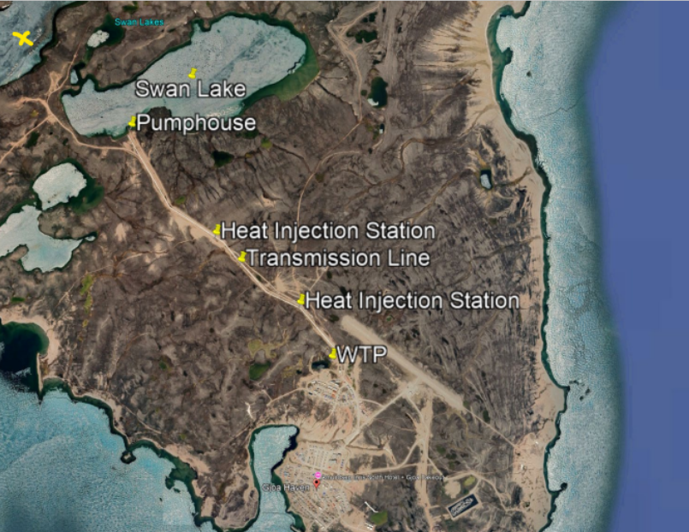
ᐅᖅᓱᖅᑑᖅ – ᓄᑖᖅ ᐃᒪᖃᐅᑎᖃᕐᕕᒃᓴᖓ - Gjoa Haven New Water Treatment Plant
ᐱᓕᕆᐊᒃᓴᐅᔪᒧᑦ ᓇᐃᒡᓕᒋᐊᖅᓯᒪᔪᖅ
Project Overview
ᑭᓱᓕᕆᔭᕆᐊᓕᖕᓂᒃ ᐱᔭᒃᓴᓂᒃ ᓴᓇᔭᐅᔪᕐᒧᑦ ᐅᑯᐊ ᐃᓚᒋᔭᐅᕗᑦ:
    ᐊᖏᖅᓴᐅᔾᔪᖏᑦ ᐃᓂᖓᑕ ᖃᓄᕆᑑᔭᕆᐊᖃᕐᓂᖓ (ᓄᓇᖓᓂ ᐃᓕᐅᖃᖅᓯᒪᓂᐊᖅᑐᑦ, ᑐᐊᐸᒃ, ᐊᕙᑖ, ᐃᑦᑕᕐᓂᑕᖃᕐᒪᖔᑦ ᐊᓯᖏᓪᓗ)
    ᐃᒪᖓ ᐃᓕᑕᐅᓇᓱᑦᑎᐊᕐᓗᓂ ᐊᒻᒪᓗ ᐃᒪᐅᑉ ᐃᑎᓂᖓ ᐆᒃᑐᕋᖅᑕᐅᓗᓂ Swan ᑕᓯᖅ ᐊᒻᒪᓗ ᐊᖏᓂᖅᓴᖅ Swan ᑕᓯᖅ ᖃᐅᔨᓂᐊᕐᒪᑕ ᖃᓄᖅ ᐊᑯᓂᐅᑎᒋᔪᖅ ᐃᒪᖃᕐᕕᐅᔪᓐᓇᕐᒪᖔᑦ
    ᖃᐅᔨᓇᓱᒃᓗᑎᒃ ᖃᓄᑦ ᓴᓇᓯᒪᔭᕆᐊᖃᕐᒪᖔᑦ ᓯᕗᓂᒃᓴᑦᑎᓐᓂ ᐃᒪᕐᒥ ᓇᑉᐸᕆᐊᓕᑦ ᐊᒻᒪᓗ ᖃᐅᔨᓇᓱᑦᑎᐊᕐᓗᒍ ᐊᑐᖅᑕᐅᒃᑲᓐᓂᕈᓐᓇᖅᑐᑦ ᒫᓐᓇᐅᔪᖅ ᓇᐸᔪᑦ
    ᖃᐅᔨᑦᑎᐊᕐᓗᑎᒃ ᓯᕗᓂᒃᓴᖓᓂᒃ ᐃᓂᖓᓂᒃ ᓱᓪᓗᖃᐅᑎᖃᕐᕕᒃᓴᖓᓂᒃ ᒥᓪᓗᐊᕈᑎᒃᓴᖓᓂᒃ ᐊᒻᒪᓗ/ᐅᕝᕙᓘᓐᓃᑦ ᐃᒪᖓᓂᒃ ᓴᓗᒻᒪᖅᓴᐅᑎᖓ
    ᐋᕿᒃᓯᓗᑎᒃ ᖃᑦᓯᑖᓚᖃᕐᓂᐊᕐᒪᖔᑦ ᐊᑭᑐᔪᓄᑦ ᑮᓇᐅᔭᒃᓴᓂᒃ ᑐᒃᓯᕋᕐᓂᐊᕐᒪᑕ
Specific tasks for the project include:
    Confirmation of Site Conditions (Geotechnical, Granular, Environmental, Archeological etc.)
    Hydrology study and bathymetric survey of Swan Lake and Large Swan Lake to determine long-term water security
    Determine the design requirements for the future water infrastructure and assess the potential reuse of existing infrastructure
    Confirming the future location of Pumphouse and/ or Water treatment plant
    Develop a cost estimate for the capital funding request
Large Swan Lake

Slide 5
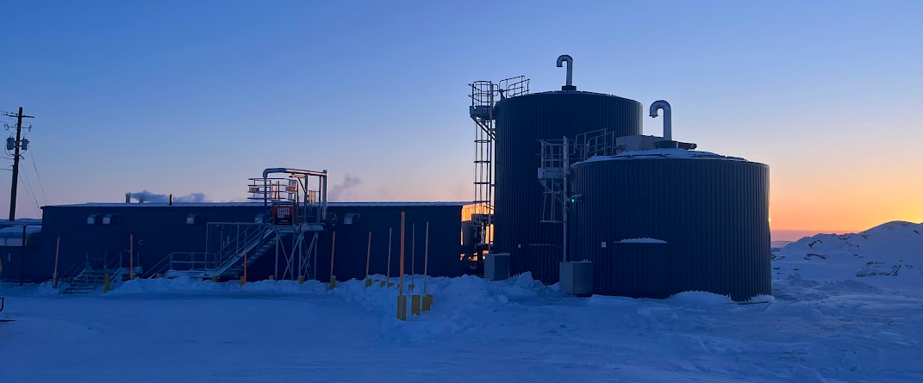
ᐅᖅᓱᖅᑑᖅ – ᓄᑖᖅ ᐃᒪᖃᐅᑎᖃᕐᕕᒃᓴᖓ - Gjoa Haven New Water Treatment Plant
ᒫᓐᓇᓵᖅ ᐊᔾᔨᖏᓐᓂᒃ ᓴᓇᔭᐅᓯᒪᔪᑦ
Recent Similar Projects
ᐊᒥᓱᓂᒃ ᐃᒪᕐᒧᑦ ᓴᓗᒻᒪᖅᓴᐅᑎᑕᓕᒃ ᓴᓇᔭᐅᓚᐅᖅᓯᒪᔪᓂᒃ ᐊᒻᒪᓗ ᓴᓇᔭᐅᒃᑲᓐᓂᕈᓐᓇᖅᑐᑦ ᐊᓯᖏᓐᓂ ᓄᓇᕗᒻᒥ ᓄᓇᓕᖕᓂ ᐊᑐᖅᓯᓗᑎᒃ ᑕᐃᒫᒃᑕᐅᖅ ᓴᓗᒻᒪᖅᓴᕐᐸᓪᓕᐊᕕᒃᓴᖓᓄᑦ:
ᑎᑭᕋᕐᔪᐊᖅ – ᓴᓇᔭᐅᓚᐅᖅᑐᖅ 2024
ᐊᐅᓱᐃᑦᑐᖅ – ᒫᓐᓇ ᓴᓇᔭᐅᔪᖅ
ᐃᒃᐱᐊᕐᔪᒃ – ᒫᓐᓇ ᓴᓇᔭᐅᔪᖅ
ᒥᑦᑎᒪᑕᓕᒃ – ᒫᓐᓇ ᓴᓇᔭᐅᔪᖅ
ᓴᓂᑭᓗᐊᖅ – ᒫᓐᓇ ᓴᓇᔭᐅᔪᖅ
Several Water Treatment Plants have been constructed or will be constructed in other Nunavut communities using similar treatment processes:
Whale Cove – Constructed in 2024
Grise Fiord – Currently in construction
Arctic Bay – Currently in construction
Pond Inlet – Currently in design
Sanikiluaq – Currently in design
ᑎᑭᕋᕐᔪᐊᖅ
Whale Cove

Slide 6
ᐅᖅᓱᖅᑑᖅ – ᓄᑖᖅ ᐃᒪᖃᐅᑎᖃᕐᕕᒃᓴᖓ - Gjoa Haven New Water Treatment Plant
ᐱᓕᕆᐊᖑᓂᐊᕐᓂᖓᑕ ᑐᑭᓕᐅᕈᑕᐅᕙᓪᓕᐊᔪᑦ
Business Case Objectives
ᓴᕿᑦᑎᓗᑎᒃ ᐃᓚᒃᓴᓕᒫᖏᓐᓂᒃ ᓴᓇᓯᒪᓂᖓᑕ ᓄᑖᖅ ᓴᓗᒻᒪᖅᓴᐅᑖ ᐃᒪᖃᐅᑎᖃᕐᕕᒃ ᐅᑯᐊᓗ ᑎᑭᐅᑎᓯᒪᔪᑦ ᑲᓇᑕᒥ ᐃᒥᖅᑕᐅᔪᓐᓇᖅᑐᓂᒃ ᐃᒪᑦᑎᐊᕙᔭᕆᐊᖃᕈᑎᖏᓐᓂᒃ ᑐᑭᒧᐊᒍᑎᓂᒃ
ᐊᖏᖅᓯᓗᑎᒃ ᓯᕗᓂᒃᓴᑦᑎᓐᓂ ᐃᒪᖃᐅᑎᖃᕐᕕᒃᓴᖅ ᐊᑯᓂ ᐊᒻᒪᓗ ᐊᑐᐃᓐᓇᐅᔪᖅ ᐃᓄᒋᐊᒃᓯᕙᓪᓕᐊᖕᒪᑦ ᑎᑭᐅᑎᓇᓱᖕᓂᖓᓄᑦ 2055
ᓇᓗᓇᐃᑦᑎᐊᖅᓯᒪᔪᑦ ᓴᓇᓯᒪᔭᕆᐊᖃᕈᑎᖏᑦᑕ ᐃᓱᒪᒋᔭᕆᐊᓕᑦ ᐱᔭᕐᓂᖅᑐᒥᒃ ᐊᐅᓚᑕᐅᓂᐊᕐᒪᑦ ᐊᒻᒪᓗ ᐅᖓᓯᒋᔭᖓᒍᑦ ᒥᐊᓂᕆᔭᐅᔪᓐᓇᕐᓗᓂ
ᐱᔭᕇᑦᑎᐊᕐᓗᒋᑦ ᖃᓄᐃᓐᓂᕆᓯᒪᔭᖓᓂᒃ ᐃᓕᑕᐅᓇᓱᒍᑎᑦ ᐃᑲᔫᑎᓂᐊᖅᑐᑦ ᓇᓗᓇᐃᔭᑦᑎᐊᕈᑎᒋᓗᒋᑦ ᓴᓇᓯᒪᓂᐊᕐᓂᖓᓂᒃ ᓯᕗᓂᒃᓴᖓᓂ ᐃᒪᖃᐅᑎᖃᕐᕕᒃᓴᖅ ᐊᒻᒪᓗ ᑐᑭᒧᐊᒍᑎᑦ ᐲᔭᕆᐊᖃᕐᓂᐊᖅᑎᓪᓗᒋᑦ ᓇᓕᐊᑐᐃᓐᓇᖅ ᒫᓐᓇᐅᔪᖅ ᓇᐸᔪᑦ ᐃᒡᓯᓇᖅᑕᐅᓕᒑᔪᒃ.
Develop a schematic design for a new Water Treatment Plant that meets Canadian Drinking Water Quality Guidelines
Confirm future source water security and availability for growing population until 2055
Outline design requirements with consideration for ease of operation & remote monitoring
Complete background studies to support the detailed design of the future water infrastructure and to guide the decommissioning of any existing infrastructure slated for abandonment.

Slide 7
ᐅᖅᓱᖅᑑᖅ – ᓄᑖᖅ ᐃᒪᖃᐅᑎᖃᕐᕕᒃᓴᖓ - Gjoa Haven New Water Treatment Plant
ᐱᒋᐊᕐᓂᖓᓂ ᓇᓗᓇᐃᖅᓯᒪᔪᑦ ᓂᕈᐊᖅᑕᐅᓯᒪᔪᓐᓇᖅᑐᑦ
Initial Identified Options
ᓂᕈᐊᖅᑕᐅᓯᒪᔪᓐᓇᖅᑐᖅ 1: ᓄᑖᖅ ᓱᓪᓗᖃᕐᕕᖓ ᑕᐃᑲᓂ Swan ᑕᓯᖅ ᓄᑖᒥᒃ ᓴᓗᒻᒪᖅᓴᐅᑎ ᐃᒪᖃᐅᑎᖃᒃᑖᕐᓗᓂ ᐊᒻᒪᓗ ᑕᓯᕐᒧᐊᖓᔪᑦ ᐃᓂᒋᔭᐅᓚᐅᖅᑐᒥᑦ ᒫᓐᓇ ᐊᑐᖅᑕᐅᓗᓂ.
ᓂᕈᐊᖅᑕᐅᓯᒪᔪᓐᓇᖅᑐᖅ 2: ᓄᑖᖅ ᓱᓪᓗᖃᕐᕕᖓ ᑕᐃᑲᓂ ᐊᖏᓂᖅᓴᒥ ᐊᖏᔪᑦ Swan ᑕᓯᖅ ᓄᑖᒥᒃ ᓴᓗᒻᒪᖅᓴᐅᑎ ᐃᒪᖃᐅᑎᖃᒃᑖᕐᓗᓂ ᐊᒻᒪᓗ ᑕᓯᕐᒧᐊᖓᔪᑦ ᐃᓂᒋᔭᐅᓚᐅᖅᑐᒥᑦ ᒫᓐᓇ ᐊᑐᖅᑕᐅᓗᓂ.
ᓂᕈᐊᖅᑕᐅᓯᒪᔪᓐᓇᖅᑐᖅ 3: ᓄᑖᖑᕆᐊᖅᑎᓪᓗᒍ ᒫᓐᓇᐅᔪᖅ ᓴᓗᒻᒪᖅᓴᐅᑎ ᐃᒪᖃᐅᑎᖃᕕᖓ ᓄᑖᒥᒃ ᒥᓪᓗᐊᕈᑎᑦ ᓱᓪᓗᖃᕐᕕᒃ ᑕᐃᑲᓂ Swan ᑕᓯᖅ, ᐊᒻᒪᓗ ᐊᑐᕐᓗᒍ ᒫᓐᓇᐅᔪᖅ ᑕᓯᕐᒧᐊᖓᔪᑦ (ᓄᑖᖑᕆᐊᖅᑎᒋᐊᖃᕐᓂᐊᖅᑐᖅ ᒪᓕᒃᑐᖅ ᖃᓄᕆᑑᓂᖓ ᖃᐅᔨᓴᖅᑕᐅᓚᐅᕐᓗᓂ).
ᓂᕈᐊᖅᑕᐅᓯᒪᔪᓐᓇᖅᑐᖅ 4: ᐃᓕᐅᖃᐃᓗᑎᒃ ᓄᑖᓂᒃ ᐃᒪᖃᐅᑎᖃᕐᕕᒃᓴᖅ ᑕᐃᑲᓂ Swan ᑕᓯᖅ ᐊᒻᒪᓗ ᐲᔭᖅᑕᐅᓗᑎᒃ ᑕᐃᑲᓃᓚᐅᖅᑐᑦ ᑕᓯᕐᒧᐊᖓᔪᑦ, ᓱᓪᓗᖃᕐᕕᖓ ᐊᒻᒪᓗ ᒫᓐᓇᐅᔪᖅ ᐊᑐᖅᑕᐅᔪᖅ ᓴᓗᒻᒪᖅᓴᐅᑎ ᐃᒪᖃᐅᑎᖃᕐᕕᖓᓂᒃ.
ᓂᕈᐊᖅᑕᐅᓯᒪᔪᓐᓇᖅᑐᖅ 5: ᐃᓕᓯᓗᑎᒃ ᓄᑖᒥᒃ ᐃᒪᖃᐅᑎᖃᕐᕕᒃᓴᖅ ᑕᐃᑲᓂ ᐊᖏᔪᑦ Swan ᑕᓯᖅ ᐊᒻᒪᓗ ᐲᔭᖅᑕᐅᓗᑎᒃ ᑕᐃᑲᓃᓚᐅᖅᑐᑦ ᑕᓯᕐᒧᐊᖓᔪᑦ, ᓱᓪᓗᖃᕐᕕᖓ ᐊᒻᒪᓗ ᒫᓐᓇᐅᔪᖅ ᐊᑐᖅᑕᐅᔪᖅ ᓴᓗᒻᒪᖅᓴᐅᑎ ᐃᒪᖃᐅᑎᖃᕐᕕᖓᓂᒃ.
Option 1: New pumphouse at Swan Lake with new water treatment plant and transmission line in relatively the same locations as the existing.
Option 2: New pumphouse at Large Swan Lake with new water treatment plant and transmission line in relatively the same locations as the existing.
Option 3: Upgrade the current water treatment plant, build a new pumphouse at Swan Lake, and maintain the existing transmission line (Upgrades as required depending on the condition assessment).
Option 4: Install a new water treatment plant at Swan Lake and decommission the existing transmission line, pumphouse and existing water treatment plant.
Option 5: Install a new water treatment plant at Large Swan Lake and decommission the existing transmission line, pumphouse and existing water treatment plant.

Slide 8
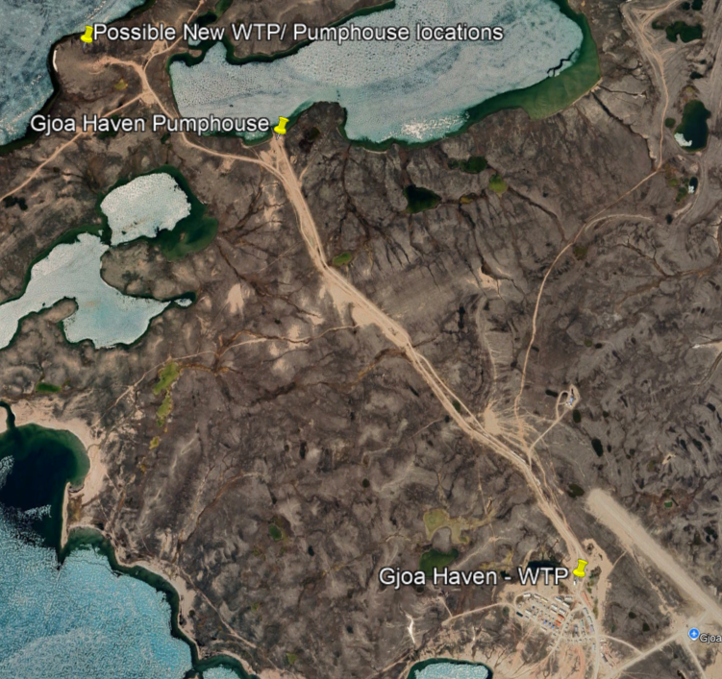
ᐅᖅᓱᖅᑑᖅ – ᓄᑖᖅ ᐃᒪᖃᐅᑎᖃᕐᕕᒃᓴᖓ - Gjoa Haven New Water Treatment Plant
ᓇᓗᓇᐃᑦᑎᐊᒃᑲᓐᓂᕐᓗᒍ ᓂᕈᐊᖅᓯᒪᔪᓐᓇᖅᑕᓯ
Confirmation of Options
ᑎᓚᓐ ᐱᑐᐃᓐᓇᕆᐊᖃᓕᖅᓯᒪᔪᖅ ᖃᐅᔨᓇᓱᑦᑎᐊᕐᓗᒍ 5 ᓂᕈᐊᖅᑕᐅᔪᓐᓇᖅᑐᖅ ᐃᒥᖅᑕᐅᑎᖃᕐᕕᖓ.
ᑎᓚᓐ ᐊᒻᒪᓗ GN-TIN ᓇᓗᓇᐃᖅᓯᑦᑎᐊᕈᒪᔪᑦ ᓂᕈᐊᖅᑕᐅᓯᒪᔪᑦ ᕼᐋᒻᓚᒃᑯᓂᑦ ᐊᒻᒪᓗ ᑐᓴᕈᒪᔪᑦ ᐅᖃᐅᓯᒃᓴᖏᓐᓂᒃ ᐅᕝᕙᓘᓐᓃᑦ ᐃᓱᒫᓘᑎᖏᓐᓂᒃ ᐱᔾᔪᑎᒋᓪᓗᒋᑦ ᐊᑐᓂ ᓂᕈᐊᖅᑕᐅᓯᒪᔪᓐᓇᖅᑐᑦ ᒪᓕᒃᖢᒋᑦ ᐃᕝᕕᑦ ᖃᐅᔨᒪᓃ˙ᑦ ᓄᓇᖓᓂᒃ ᐊᒻᒪᓗ ᓄᓇᓖᑦ ᐱᔪᒪᔭᖏᓐᓂᒃ.
Dillon is prepared to evaluate 5 options for the water system.
Dillon and GN-TIN would like to confirm the options with the Municipality and hear comments or concerns about each option based on your knowledge of the area and community needs.

Slide 9
ᐅᖅᓱᖅᑑᖅ – ᓄᑖᖅ ᐃᒪᖃᐅᑎᖃᕐᕕᒃᓴᖓ - Gjoa Haven New Water Treatment Plant
ᓴᓗᒻᒪᖅᓴᖅᑕᐅᓂᖓᓄᑦ ᐱᓕᕆᓂᐅᔪᖅ
Treatment Process
ᒪᓕᑦᑎᐊᕐᓗᑎᒃ ᒐᕙᒪᑐᖃᒃᑯᑦ ᐊᒻᒪᓗ ᑎᐅᓕᑐᐊᓕᔅ ᐱᐅᓯᖏᓐᓂᒃ ᐃᒥᕆᔭᐅᔪᓐᓇᖅᑐᓂᒃ
ᐱᔾᔪᑎᕗᑦ ᖃᐅᔨᓇᓱᑦᑎᐊᕈᒪᓪᓗᑎᒍᑦ ᓄᓇᕗᒻᒥ ᐱᐅᓯᑦ ᐃᒪᕐᒧᑦ ᓴᓗᒻᒪᖅᓴᐅᑎᑦ (SWTT) ᓈᒻᒪᒐᔭᕐᒪᖔᑕ ᐅᖅᓱᖅᑑᕐᒧᑦ, ᐊᑐᖅᓯᓗᑎᒃ ᖃᐅᔨᒪᔭᐅᔪᓂᒃ ᑐᑭᓯᑎᑕᐅᓗᑎᒃ ᐊᕙᑖᓂᑦ ᓄᓇᓕᖕᓂ
ᓄᓇᕗᒻᒥ ᐱᐅᓯᑦ ᐃᒪᕐᒧᑦ ᓴᓗᒻᒪᖅᓴᐅᑎᑦ ᐱᓕᕆᔭᐅᔾᔪᓯᖓ: ᖃᐅᔨᓇᓱᑦᑎᐊᕐᓗᒍ, ᓇᓗᓇᐃᔭᕆᐊᓕᑦ, ᐆᒪᔪ ᐲᔭᕆᐊᓕᑦ, ᓱᓪᓗᖓ, ᐃᒪᐅᑉ ᓴᓗᒻᒪᖅᓴᐅᑖ ᐃᓚᒃᓴᖓ ᐊᒻᒪᓗ ᐃᑯᒪᔪᒃᑯᑦ ᖁᐱᕐᕈᐃᔭᐅᑎ
ᑐᕌᖅᑕᖓ ᓴᓇᓯᒪᔪᖅ ᓱᕋᑲᐅᑎᒋᔮᓐᖏᒻᒪᑦ ᓴᓗᒻᒪᖅᓴᐅᑎᖃᕐᕕᖓ
Adheres to Federal and Territorial standards for drinking water
Intention is to evaluate Nunavut’s Standard Water Treatment Train (SWTT) for its suitability in Gjoa Haven, fostering knowledge sharing between communities
SWTT process: screening, clarification, organics removal, filtration, chlorination and ultraviolet light disinfection
Goal is to design a resilient treatment system

Slide 10
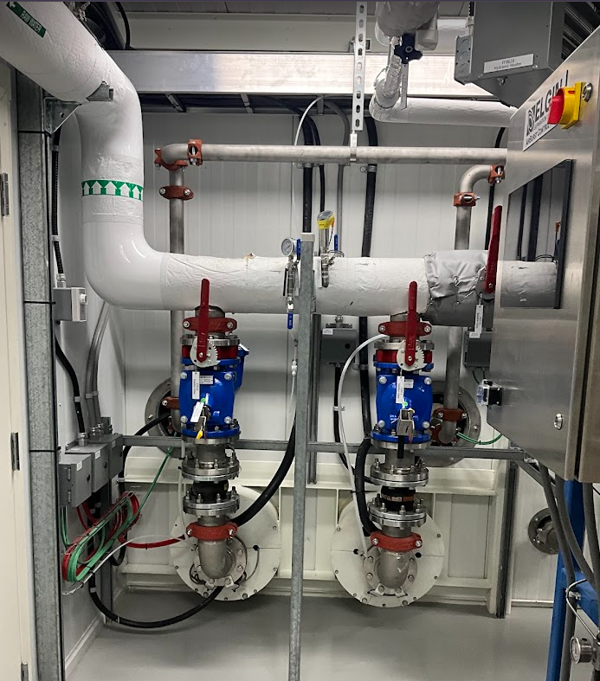
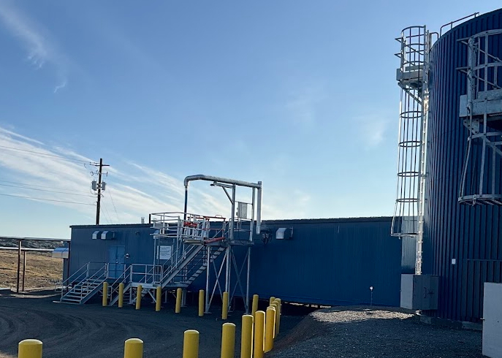
ᐅᖅᓱᖅᑑᖅ – ᓄᑖᖅ ᐃᒪᖃᐅᑎᖃᕐᕕᒃᓴᖓ - Gjoa Haven New Water Treatment Plant
ᓴᓗᒻᒪᖅᓴᖅᑕᐅᓂᖓᓄᑦ ᐱᓕᕆᓂᐅᔪᖅ
Treatment Process
  ᐃᖏᕐᕋᐃᓐᓇᕆᐊᓕᖏᑦ ᐊᒻᒪᓗ ᐊᓯᖑᕆᐊᓕᑦ ᐱᓕᕆᔾᔪᑖᒍᑦ ᐊᐅᓚᑕᐅᑦᑎᐊᕐᓗᑎᒃ
  1-2 ᐅᓪᓗᓄᑦ ᓴᓗᒪᔪᑦ ᐃᒪᖓ ᖃᑦᑕᖓᓃᓪᓗᓂ ᖁᓛᓂ ᓄᓇᐅᑉ
  ᓴᓇᓯᒪᔪᖅ 20 ᐊᕐᕌᒍᓄᑦ ᓄᓇᓕᖕᓂ (2055) ᐊᒻᒪᓗ ᐊᑯᓂᐅᔪᒃᑯᑦ ᐃᖏᕐᕋᑦᑎᐊᖏᓐᓇᕈᓐᓇᖅᑐᖅ ᑎᑭᐅᑎᓗᓂ 2100.
  ᑐᐊᕕᒃᓇᖅᑐᖅᓯᐅᑖ ᐃᑯᐊᓚᔪᖃᖅᑎᓪᓗᒍ ᑯᕕᕕᖓ
  Redundancy and flexibility in system operations
  1-2 days of treated water storage in aboveground tank
  Designed for the 20-year community build-out (2055) and long-term viability until 2100.
  Emergency fire flow bypass

Slide 11
ᐅᖅᓱᖅᑑᖅ – ᓄᑖᖅ ᐃᒪᖃᐅᑎᖃᕐᕕᒃᓴᖓ - Gjoa Haven New Water Treatment Plant
ᓂᕆᐅᓇᖅᑐᖅ ᖃᖓᒃᑯᑦ ᓴᓇᔭᐅᓇᔭᕐᓂᖓ
Anticipated Project Timelines
ᐱᓕᕆᐊᖑᓂᐊᕐᓂᖓᑕ ᑐᑭᓕᐅᕈᑕᐅᕙᓪᓕᐊᔪᑦ ᓂᕆᐅᓇᖅᑐᑦ ᐱᔭᕇᕐᓗᑎᒃ ᐅᑭᐊᒃᓵᖅ 2026.
GN-TIN ᐊᒻᒪᓗ ᑎᓚᓐ ᐅᖃᐅᓯᕆᓂᐊᖅᑕᖏᑦ ᑭᖑᓪᓕᖅᐹᖅᓯᐅᑎᑦ ᐊᑐᓕᖁᔭᐅᔪᑦ ᐊᒻᒪᓗ ᑐᒃᓯᕋᕐᓗᑎᒃ ᑲᑎᒪᔨᑦ ᐱᖁᔨᕗᖔᓕᐅᕐᓗᑎᒃ ᑲᔪᓯᓂᐊᕐᒪᑦ ᓇᓗᓇᐃᑦᑎᐊᖅᓯᒪᓂᐊᕐᓂᖓ ᓴᓇᓯᒪᓂᐊᕐᓂᑕ
ᓯᕗᓂᒃᓴᑦᑎᓐᓂ ᖃᓄᐃᑉᐸᓪᓕᐊᓂᕆᓂᐊᖅᑕᖓ (ᒪᓕᒃᑐᖅ ᑮᓇᐅᔭᒃᓴᖃᖅᑎᑕᐅᒍᓂ):
ᐱᖁᔭᕋᓛᑦ ᐊᖏᖅᑕᐅᓗᑎᒃ
ᓇᓗᓇᐃᔭᑦᑎᐊᕐᓗᒍ ᓴᓇᓯᒪᓂᐊᕐᓂᖓ
ᓴᓇᔭᐅᓂᖓ
Business Case is expected to be completed by the end of Fall 2026.
GN-TIN and Dillon will present the final recommendations and request a Council motion to proceed with detailed design
Future Phases (subject to funding):
Regulatory Approvals
Detailed Design
Construction

Slide 12
ᐅᖅᓱᖅᑑᖅ – ᓄᑖᖅ ᐃᒪᖃᐅᑎᖃᕐᕕᒃᓴᖓ - Gjoa Haven New Water Treatment Plant
Questions?
ᐊᐱᖅᑯᑏᑦ?

